Slide 1
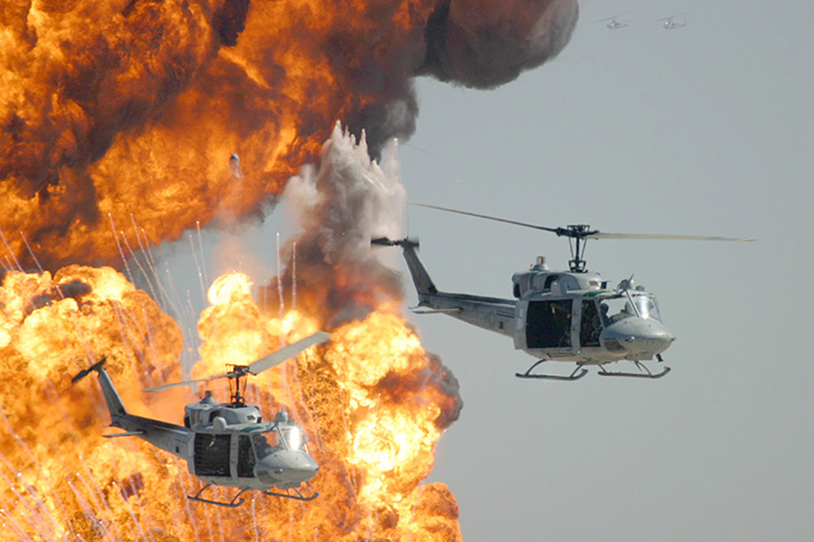


Emergency Response Planning
Deputy Bryan Smith
ALEA Safety Program Manager

Slide 2
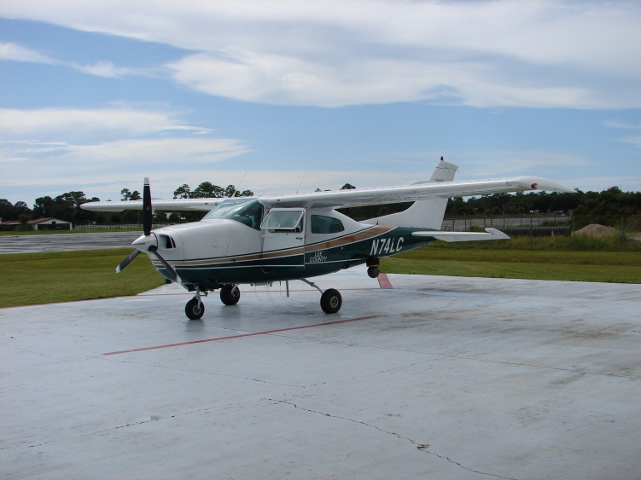
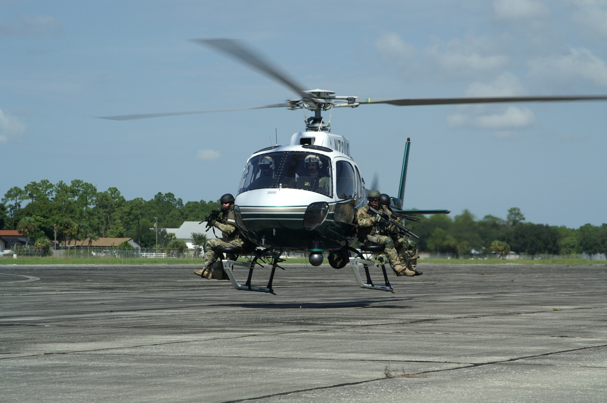
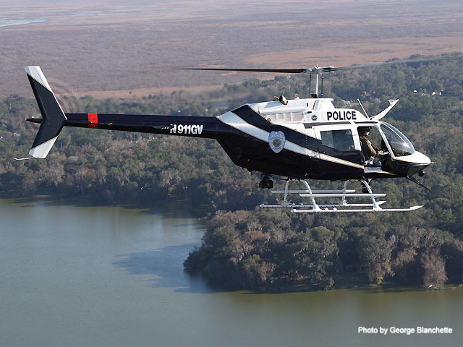
Who’s this guy?
Throughout this presentation there will be several text boxes such as this one which help explain the slides in more detail, as I would during live presentations. I have also removed videos to reduce file size for online storage. If you have further questions, or would like the original presentations with videos, please contact me. safety@alea.org
These presentations are copyrighted by ALEA. They are for ALEA member educational use only and not to be used for commercial purposes.
If you have not done so already, be sure to start the slideshow in order to see the slides properly. Hit [F5] or click on SLIDESHOW above and then FROM START.
Thanks,
Bryan
Bryan Smith
ALEA Safety Program Manager

Slide 3
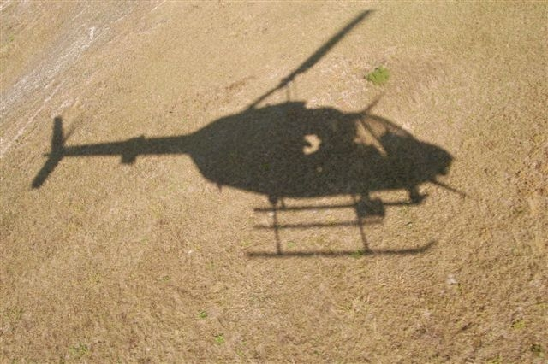

Introduction
  Why a Mishap Plan?
  Hard Lessons Learned
Recommended Plan Components
  Defined Initiation Criteria
  Format and Availability
  Defined Roles
  Additional SAR Resources
  Checklists
Implementation
  Internal and external training
Review and Discussion

Slide 4
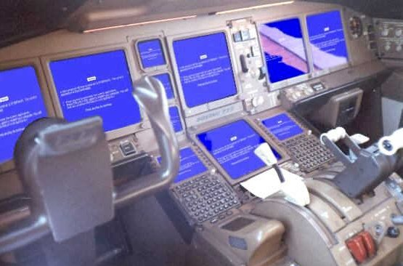
“People have always asked me if I was afraid.
I wasn’t…
Constructive apprehension is more like it”
John Glenn on Mercury ‘Friendship 7’ flight.

Slide 5
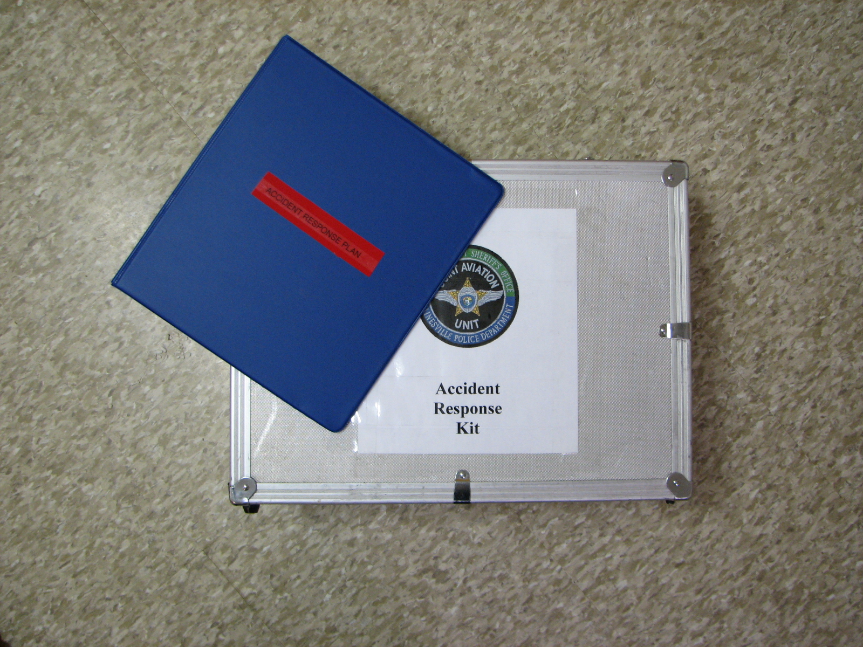
Why make a plan?

Slide 6
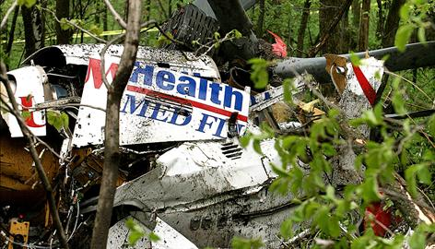
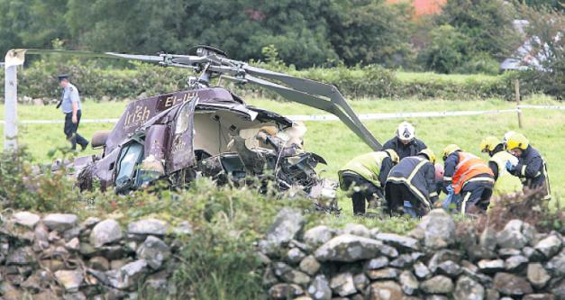
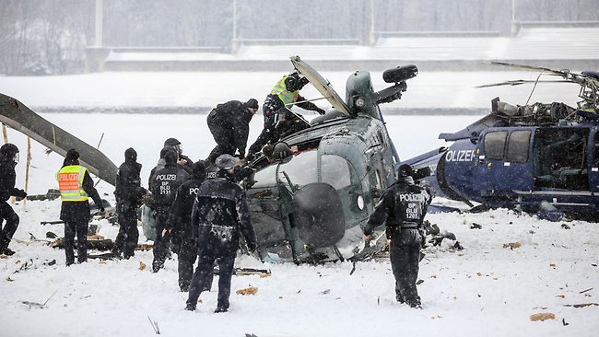
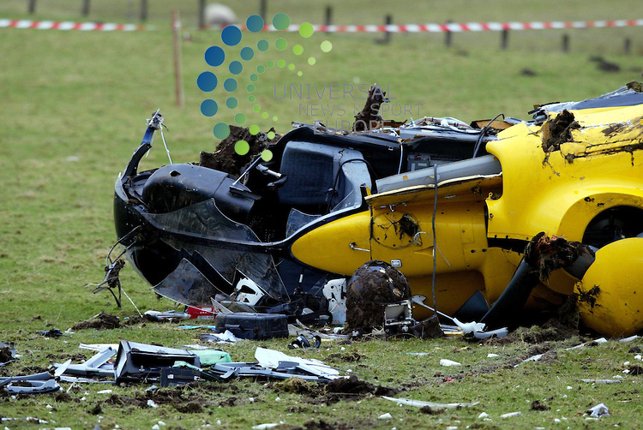
Exercise
Take out a piece of paper and write down what you would do if…
The communications center calls and informs you that one of your aircraft went out on a flight and never returned. They are unable to contact the crew by radio or phone, there is no ELT signal, no 911 calls about an aircraft down. The Chief Pilot and Safety Officer were aboard…what do you do?
The aircraft still has not been found. The news caught wind of the story and the Chief Pilot’s wife just saw the story on the news, she is calling you.
The aircraft was just found, it is in a forested area 2 miles away from the nearest road. A bank robbery was just dispatched and they are asking for air support.
The PIO just told you that the Chief expects you to join him for a press briefing. What information can you disclose?
Who conducts the investigation?
What do you do with the aircraft?

Slide 7
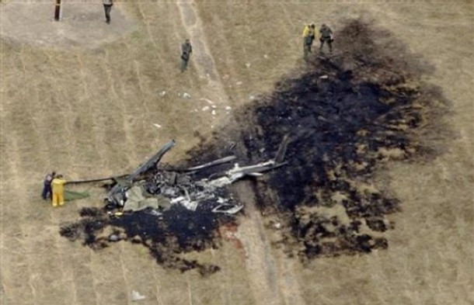
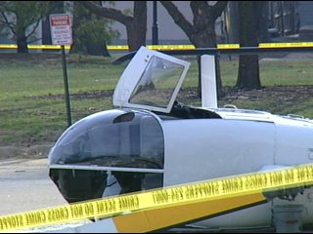
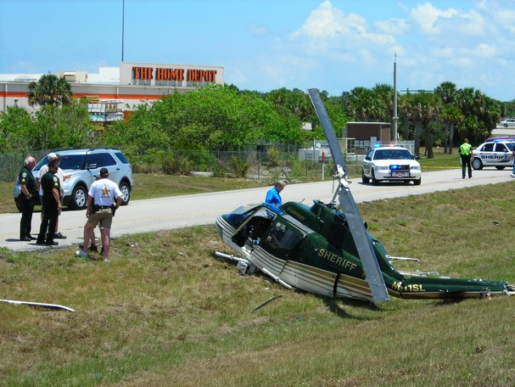
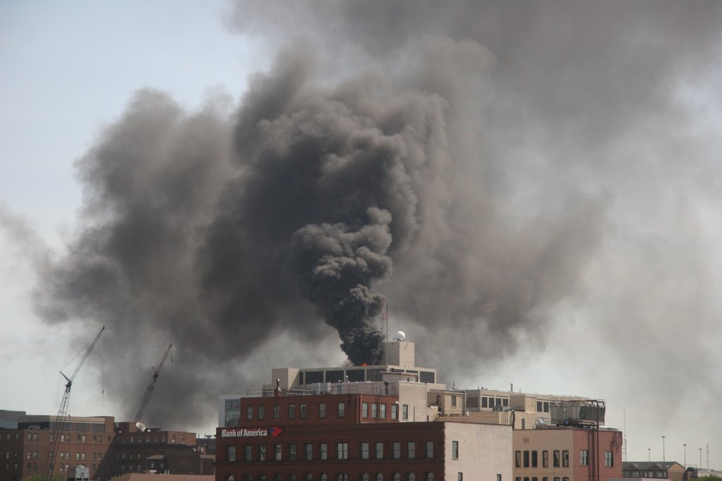


Are you ready for this?
How long will it take your agency to know the aircraft is missing?
How do you secure an aircraft accident site?
How are you going to find a missing aircraft?
What happens if the guy in the accident is the only one in the unit trained to respond to one?
Will you send
your crews and aircraft to look?
How do I contact the FAA/NTSB/CAP or Air Traffic Control?
What can I tell the media?
When and how do I remove the aircraft?

Slide 8
Law Enforcement Reported Accidents
2012
Helo – Unknown (Canada)
Helo – Training (Hover Auto)
Helo – Autorotation into trees
Helo – Departure from controlled flight during low level SAR work
Helo – TFO fatal injury, fell
Helo – TFO hit in head with blade
Helo – Fuel exhaustion
Helo – Engine failure
Helo – System failure (tail section)
Fixed – Eradication flight, unknown
Helo – Training (Auto)
Helo – Engine failure
Helo – Wire Strike (*)
2010
Helo – Fuel exhaustion
Helo – Hydr Failure Training, rollover
Helo – Gearbox failure
Helo – Practice Auto
Helo – Practice Auto
Helo – Engine failure
Helo – Tail rotor strike during landing
Helo – Wire strike (fatal x4)
Airplane – Pilot medical issue
Airplane – Hard landing/LOC
Airplane – LOC during taxi on ice
Airplane – Carb Ice
Airplane – IIMC/CFIT
2011
Helo – Loss of Control (LTE at a 200ft OGE hover)
Helo – Loss of Control (LTE while landing)
Helo – Damage from hangar debris
Helo – Autorotation Training
Helo – Nose over during run on landing, blade strike
Helo – Low side gov failure
Airplane – Failed to extend
landing gear
Airplane – IIMC/CFIT in snow
Year Accidents Fatalities
2013
Helo – CFIT (3)
Helo – White Out - Spatial Disorientation (1)
Helo – Engine Failure
Helo – Engine Failure
Helo – LTE
Helo – Fast rope fall (2)
Helo – Training auto
Helo – Training auto
2013 8 6
2012 13 7
What are the chances?
2011 8 2
2010 13 8
2009 12 2
2008 8 5

Slide 9
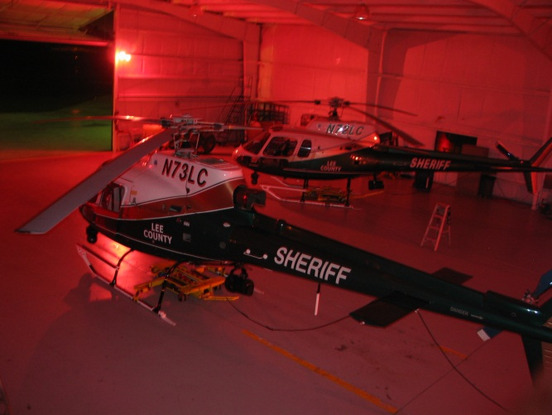
Law Enforcement Reported Accidents
Totals Accidents Fatalities
Type
CFIT** 5 ( 11 )
LTE 6 ( 3 )
Wire Strike 2* ( 6 )
Training 18 ( 2 )
  Autos 13
  Hydr 3
Mechanical Failure 13.5 ( 0 )
Landing LOC (airplane) 3 ( 0 )
2008-2013 62 30
Average/year 11.2 5.4
** note: With the exception of one medical issue, and one stall/spin*, all LEO fixed wing fatalities due to CFIT

Slide 10
Hard Lessons to Learn…
11:58 Crash
12:14 First attempt to figure out where crew landed
12:21 Lat/Long Coordinates given to state police units are in different format. Search begins 40 miles away from actual crash site. Second State Police helo launched to look.
12:31 ATC calls State Police wondering why incident helo has not landed there. Second helicopter aborts search due to fog.
12:56 State Police declare incident helo missing. Victim families begin calling State Police looking for info on loved ones. They are told, “We don’t know”
01:30 Supervisor discovers a mishap plan for missing aircraft has not been activated
01:59 Two officers take it upon themselves to look for aircraft based on flight plan and find crash site by following in screams and smell of fuel.
18:51 Launch for SAR call
20:30 Subject located, landed to hike to bring her back to helo
21:32 Launch from mountain landing area
21:35 Crash
22:40 ELT Detected by USAF SAR (406 and 121.5)
11:55 (next day, 14.5 hrs. after crash) sole survivor located hiking down mountain
13:11 Survivor airlifted off mountain
18:16 Aircraft wreckage located

Slide 11
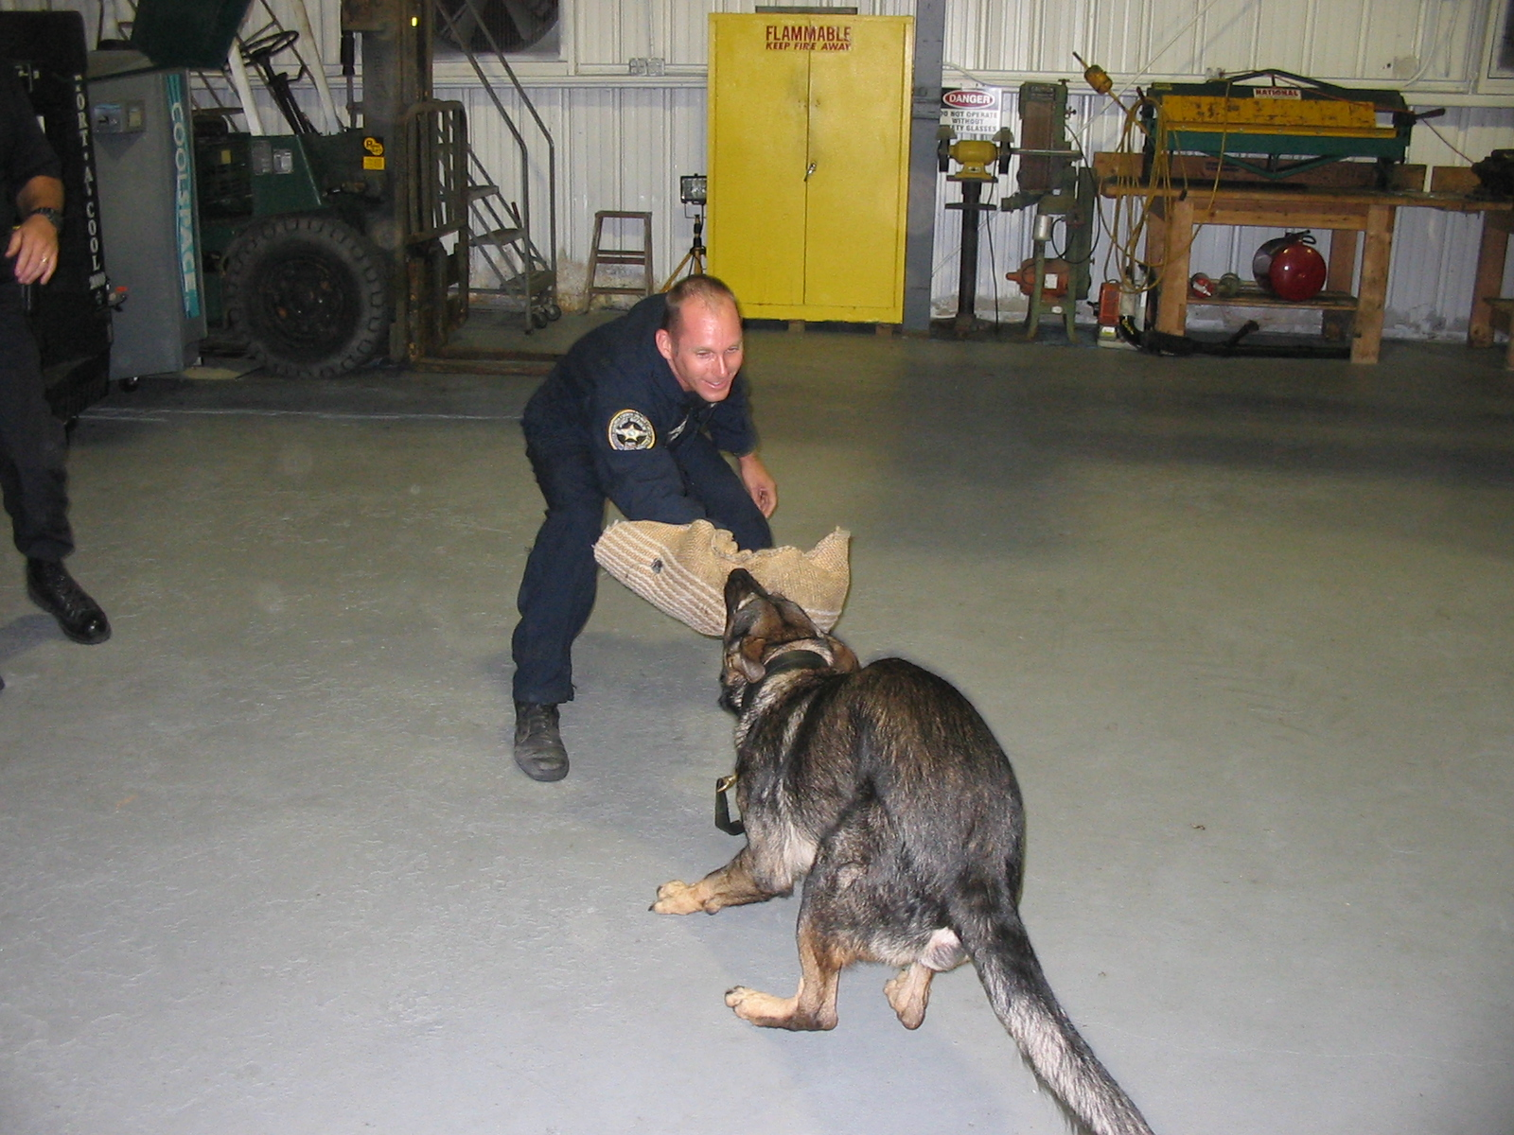
Who do you trust?
Fastest SAR availability
Firsthand knowledge of aircraft and crew
NTSB and FAA unavailability and inexperience in airborne LE ops
Control of information
Lack of aviation knowledge (supervisors, fire/rescue, media, SAR teams)
Proper care of crew and family
Most of us are just one poorly handled incident away from going out of business
We are unique in aviation as we are the ones others usually call when their aircraft go down

Slide 12
A copy of this plan is available on the ALEA website, under the SAFETY FIRST tab
What Should the Plan Look Like?

Slide 13


Written Response Plan
Keep length to a minimum
Availability of plan (hard copy, intranet, etc.)
Defined tasks for designated positions
Provide backups
Quick reference sheets
Response kit
Personal data sheet
Recovery Plan

Slide 14
Written Response Plan - PSAAC
g. NTSB/TC
h. Legal advisor/risk manager
i. Medical Examiner/Coroner
j. Aircrew family notification
k. Aircraft manufacturer
l. Aircraft or other equipment manufacturers
m. Unit commander/manager
n. Media
5. Accident investigation kit with responsibilities and procedures
6. Accident witness statement forms
7. Availability of services at key locations
8. Procedures for follow-up family care
9. All unit personnel shall be trained in the implementation of the unit accident/emergency response plan. There shall be a record of the training in the unit member’s training records.
10. Damaged aircraft recovery procedures
03.02.04 Emergency Preparedness and Response: Unit Accident Plan: The aviation unit shall have a written accident plan detailing the procedures and notifications to be followed in the event of an accident or serious incident. as part of the unit’s Safety Management System. The plan shall be incorporated into the unit’s policy mandating compliance in the event of an accident or serious incident involving substantial damage to aircraft, injury or death of crewmembers, passengers or persons on the ground. The accident plan shall also address aviation ground accidents and incidents not involving aircraft flight operations. The plan shall include, but not limited to:
1. Individual actions that shall be taken in the event of an accident.
2. Scene security and containment, identification of, collection and preservation of evidence, first at scene checklist.
3. Current contact information for all unit personnel.
4. Immediate response checklist and notification procedures, including telephone numbers for:
      a. EMS/Fire/Rescue
      b. Command notification
      c. Forensics/Crime Lab
      d. FAA/TC Air Traffic Control facilities
      e. Other law enforcement units
      f. Medical care facilities

Slide 15
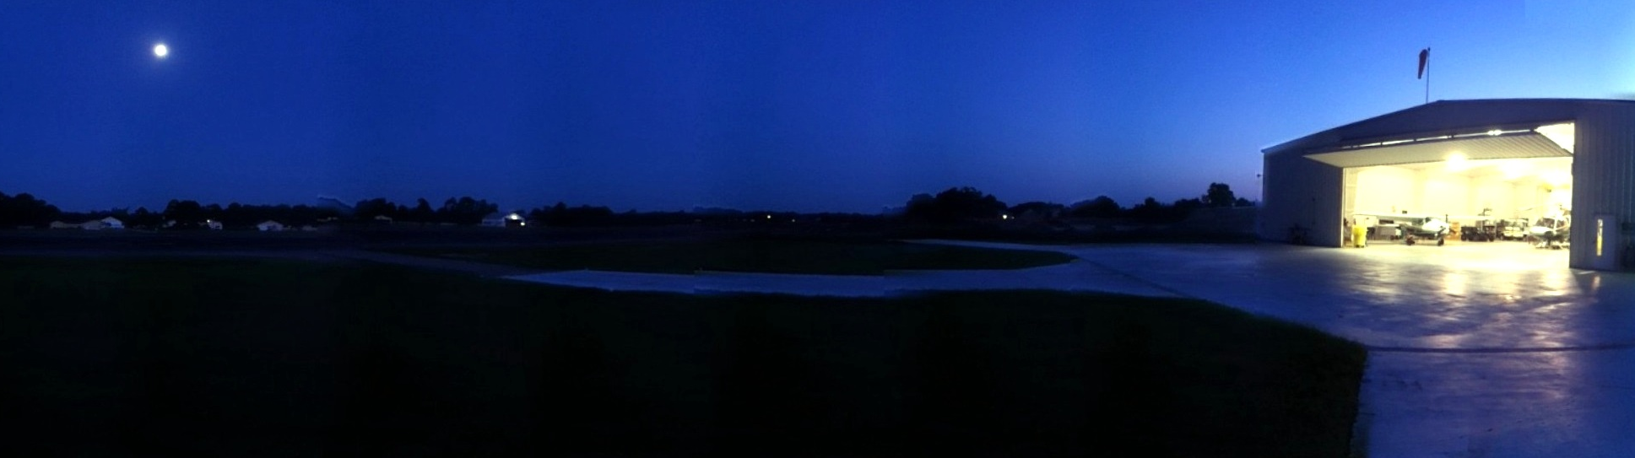
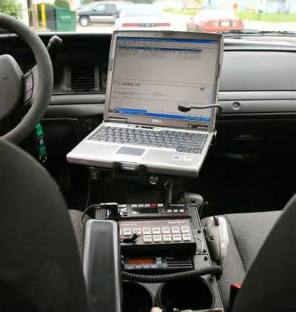



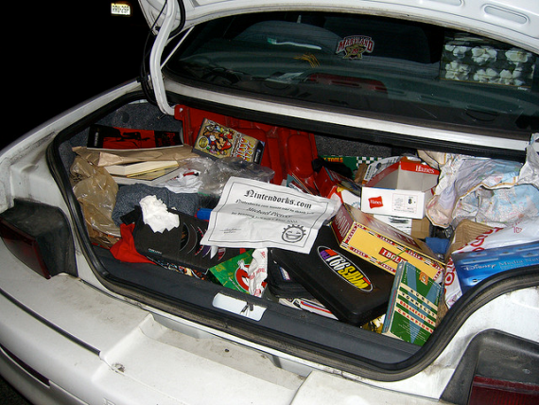
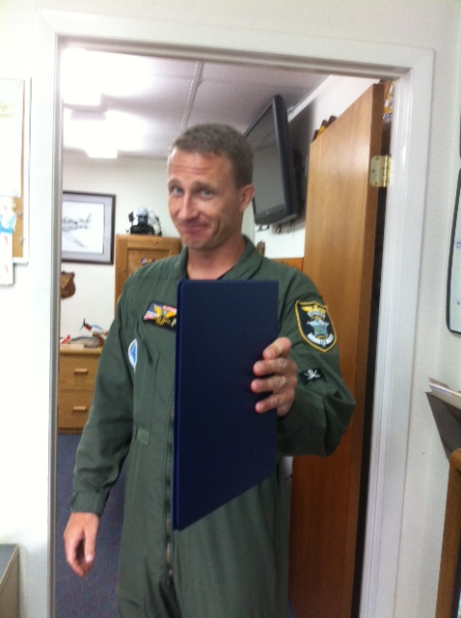
Availability of plan
Hard copy in several places
(shift commander, communications center, aviation office, etc.)
Must be available to officers on the road.
Computer or hard copy.

Slide 16
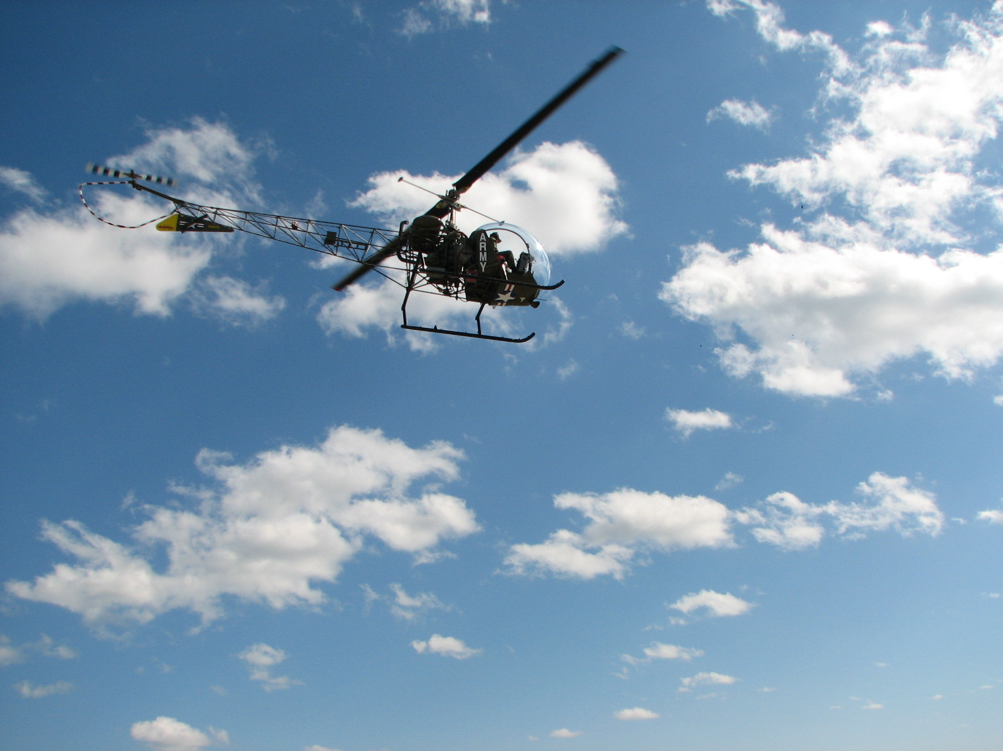
Initiation of ERP
Aircrew does not answer routine check for ten minutes.
Aircrew is more than 30min past due on cross country, maintenance or administrative type flight.
Aircraft Emergency Locator Beacon is activated
Aircrew advises via radio they are in an emergency situation
911 call advises aircraft in emergency situation (and unable to confirm otherwise with aircrew)
If any of these criteria are met, initiate the
Emergency Response Plan Immediately.

Slide 17
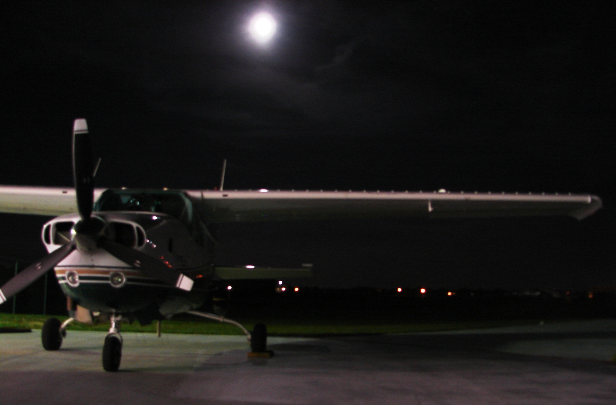
“Incomprehensible jargon is the hallmark of a profession.“
--Kingman Brewster Jr.

Slide 18
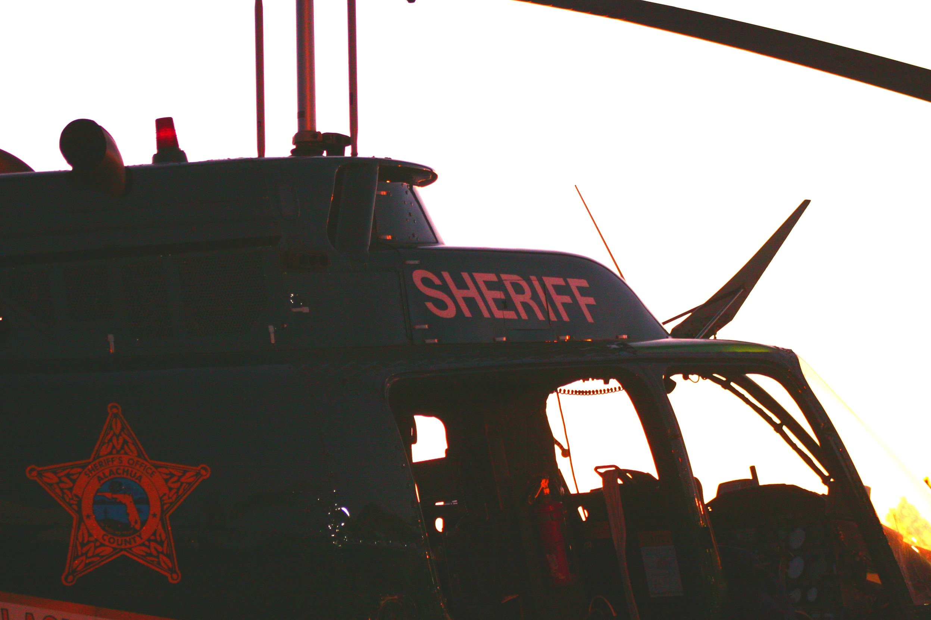
Designated Jobs
Communications Center
Shift Supervisor
Air Unit Commander
Chief Pilot
Aviation Safety Officer
Maintenance Technician
Unit Staff
Public Information Officer

Slide 19
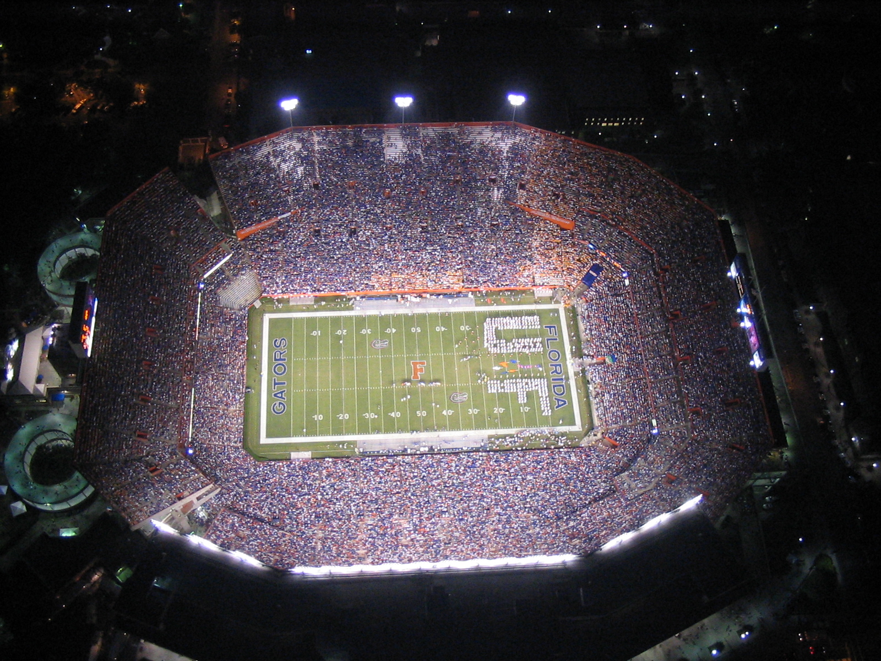
Communications Center
Initiate Plan
Crew contact (radio, phone, pager, etc)
Supervisor Contact (Patrol and Air Unit)
Resource Contact (Other agencies, USCG, CAP, ATC)
Unit member contact (per Response Plan)
Plan must provide all contact numbers.
Specify when to call whom and exactly what to ask for.
DO NOT allow calls to your home from Com Center!

Slide 20
Communications
Quick Reference Guide
Per Unit Commander / Shift Commander
Additional Air Unit Staff called out
Call Civil Air Patrol (US Air Force) and request aircraft and ground teams [757-764- 8112]
US Coast Guard S&R request [904-247-7311 / 904-630-6130]
Contact Bob County Sheriff’s Office for Aviation Support [555-9876]
Aircraft location known:
Verify Unit Commander and/or Chief Pilot aware of location
Shift Commander notified
Fire/Rescue dispatched (HAZMAT also)
EMS Dispatched
Patrol units sent to scene to establish scene perimeter/security
Forensics/ Crime Scene dispatched
Supervisor dispatched to scene
Update Tower and/or Air Traffic Control
Update Air Force/ Coast Guard / CAP/ Bob County Sheriff’s Aviation
If aircraft location unknown:
Call Unit Office [555-1234]
Page crewmembers’ radios
Call numbers on Daily Roster
Shift Commander Notified
Send patrol unit to Unit hanger
Patrol units BOLO for aircraft
Call Unit Commander
Call Tower [555-4321]
After 2230hrs: Call Air Traffic Control Center [321-123-4567]
DO NOT contact aircrews’ homes without Unit Commander or Chief Pilot authorization
PIO Contacted

Slide 21
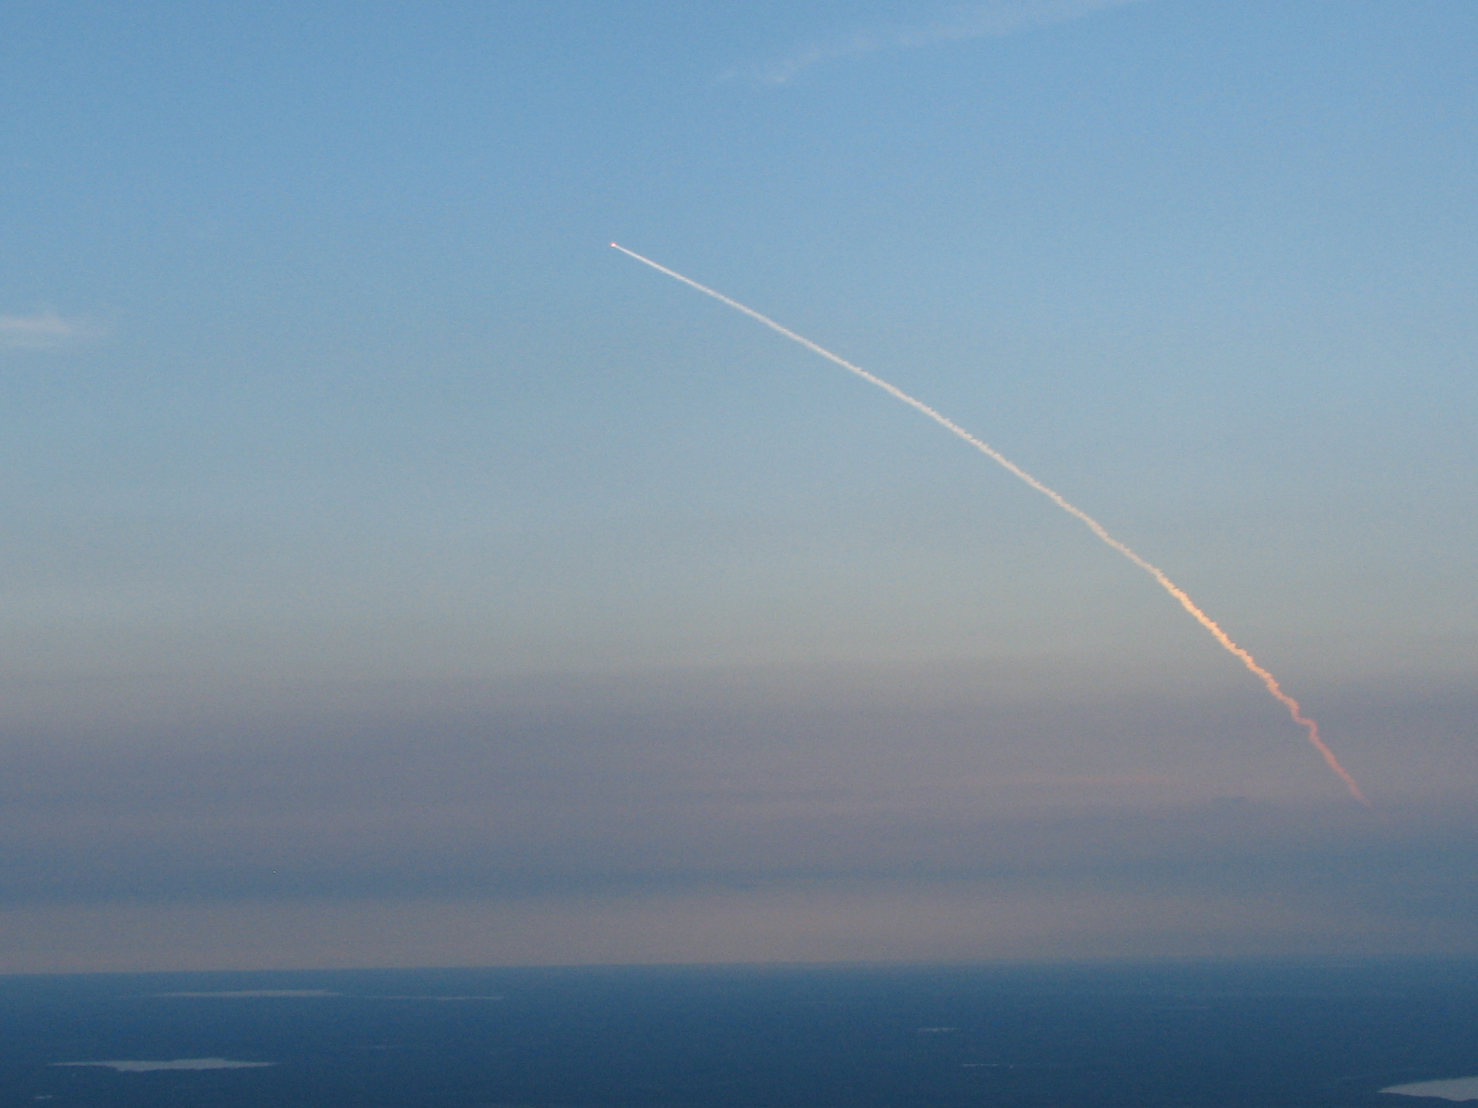
Shift Commander
Deploy patrol units for search
Set up command post
Coordinate search
Deploy other resources (USCG, other agencies, CAP, etc.)
Secure scene (Fire/Rescue, CSI, Air Unit staff)
Non-aviation savvy supervisors need to have every step laid out for them.
Command post set up at aviation office to better manage incident.

Slide 22
Shift Commander
Quick Reference Guide
If aircraft/crew location is unknown:
Time and location of Air-1’s last unit check ____________________________
Control tower/ Air Traffic Control location information_____________________
Begin log of areas searched, including unit number and time
Establish command post at Air Unit Hanger
Refer to Search and Rescue checklist
Additional Agencies Responding:
Name Contact number
_______________ ________________
_______________ ________________
If the location of the aircraft becomes known before JAU staff arrives:
Instruct on-scene units to establish incident scene (500 feet from aircraft, debris and any areas containing collateral damage)
Confirm if aircraft is ‘safe’ (engine off)
-If not-
Air Unit staff contacted by phone on how to proceed, or see section 6
Assign supervisor control of incident scene
Unit assigned to begin log of persons entering scene
Blood type/ allergy info on Contact Sheets relayed to EMS

Slide 23

Air Unit Commander
Take over for Shift Commander
Coordinate all resources
Incident Commander
This portion of your planning will be greatly effected by how knowledgeable the Unit Commander is on aviation topics
The Commander must coordinate resources, not try and do the work themselves

Slide 24
Air Unit Commander
Quick Reference Guide
If location of aircraft is unknown:
Command Center established at Unit office
Confirm who is involved in the incident
Call out additional Air Unit staff
Tower/ ATC contacted
Search plan established. Establish or adjust as necessary. Refer to Search & Rescue checklist
Additional Resources Contacted (Bob County S.O., CAP, USCG, etc.)
Search areas defined for Additional Resources.
Once the aircraft is located:
Confirm condition of aircrew
Fire/Rescue and EMS en route
Supervisor assigned to establish incident scene (500 feet from aircraft, debris and any areas containing collateral damage)
Confirm if aircraft is ‘safe’ (engine off)
-If not- Provide instructions or have Unit staff en route to make aircraft safe
If crew is transported to hospital, send two Air Unit members
Blood type/ allergy info on Contact Sheets relayed to EMS
Unit assigned to begin incident scene log
Unit staff en route to scene (Chief Pilot, Maintenance Tech & Safety Officer)
Unit staff en route to hospital if required (On-Call TFO/pilot)
Tower, FAA , ATC and other S&R resources updated
Unit Staff assigned to contact crewmembers’ family if required
PIO Updated
Begin aircraft recovery plan when cleared to do so by NTSB or Insurance carrier

Slide 25
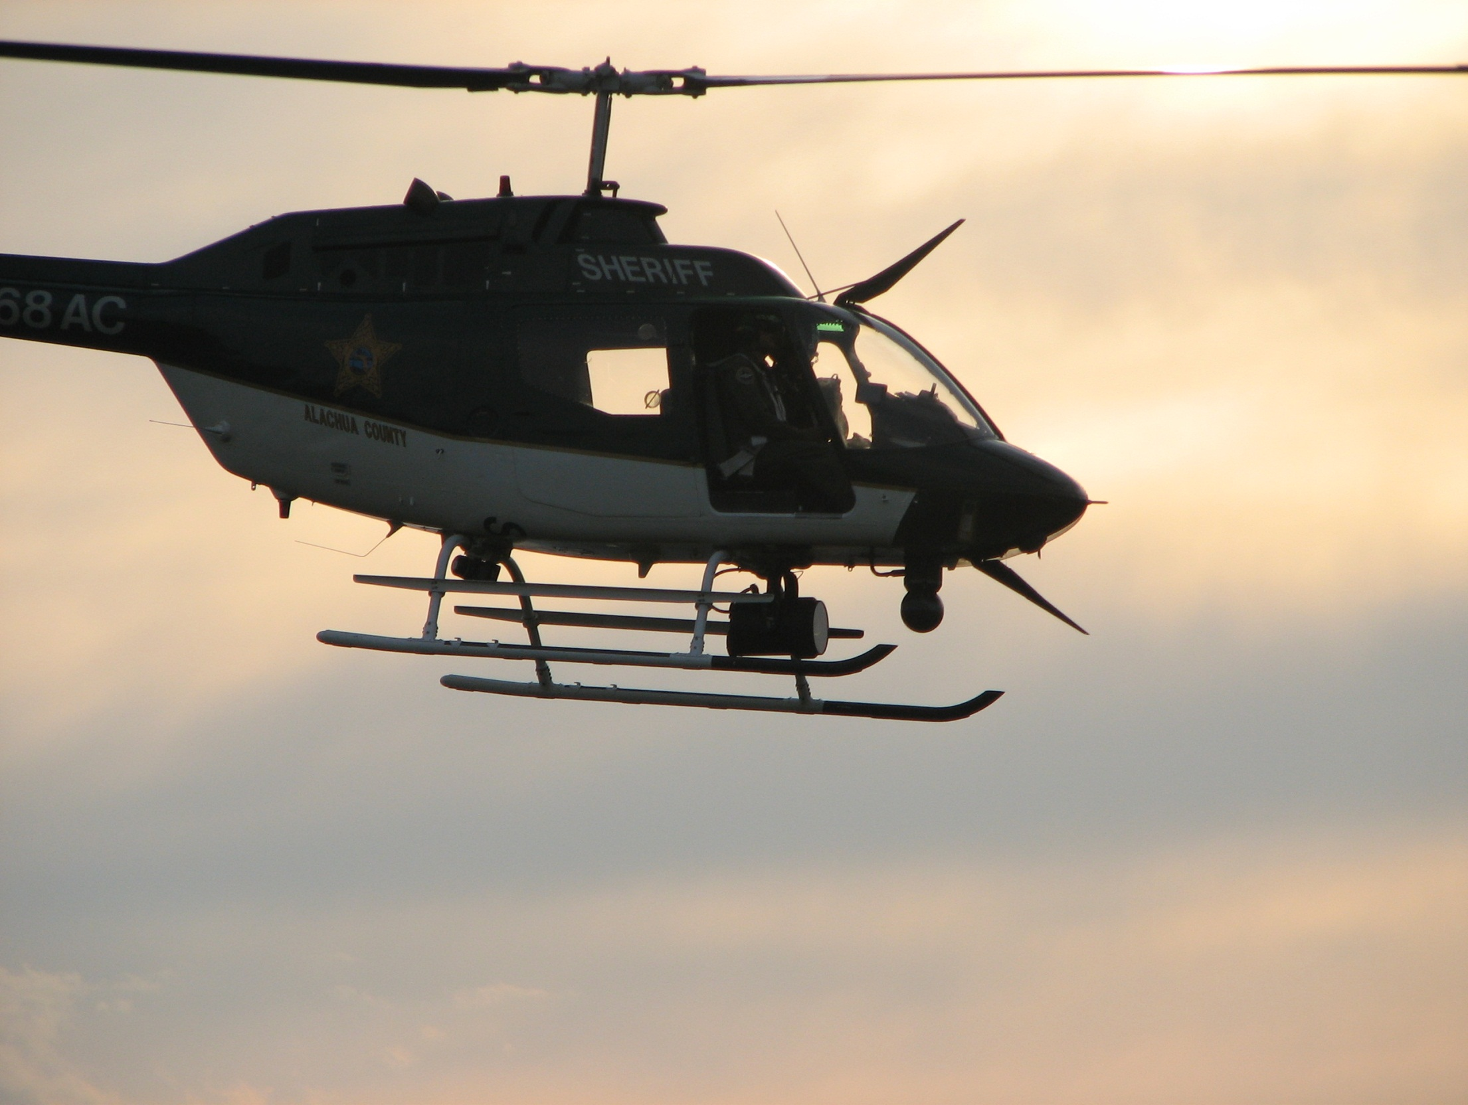
Chief Pilot
Coordinate airborne search efforts
Obtain WX info for search and investigation
Respond to incident site – on scene commander

Slide 26
Chief Pilot
Quick Reference Guide
Once the aircraft is located:
Confirm aircraft safe
-if not-
Provide instructions on how to make aircraft safe if crew needs to be rescued and Unit staff not close to site.
Retrieve Accident Response Kit
Retrieve camera
Incident scene perimeter adequate
Fire/EMS/HAZMAT en route
Accident site sketch
Photos of site and aircraft
Identify and interview witnesses, first responders, ATC (including crew if possible)
Fuel samples obtained
Obtain info on call the crew was working
Obtain WX info at estimated time of accident
Complete an incident report
Assist with aircraft recovery
Respond to hanger and prepare aircraft for SAR ops
If location of aircraft is unknown:
TFO en route
Obtain and record current weather info
Contact Shift Commander or Unit Commander on status of search and last known location.
Coordinate with other aviation assets the Commander has requested (specify altitude AND search area separation.
First Aid kit/ survival bag in aircraft
Confirm fuel sample taken

Slide 27
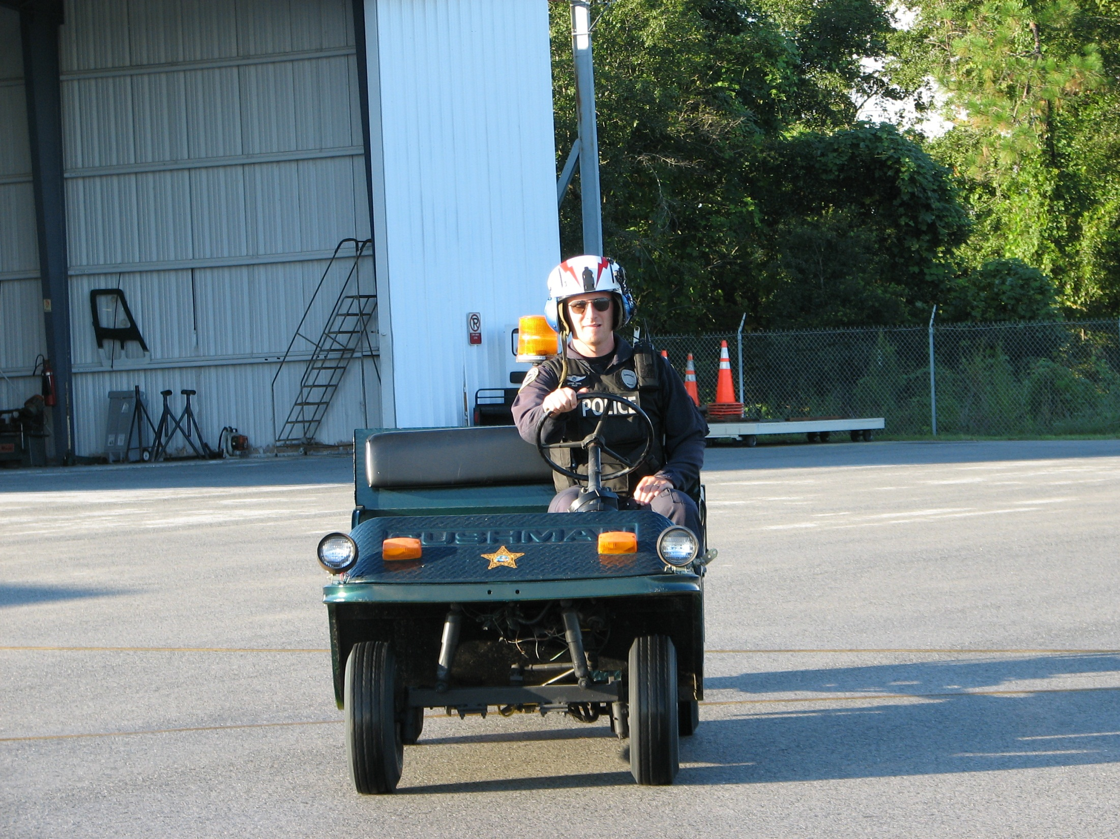
Safety Officer
Assist with S&R until aircraft located
Ensure safety is maintained during search
Assist Chief Pilot with accident
investigation (Or do investigation if
also the unit crash investigator)
Complete after action report on safety
issues

Slide 28
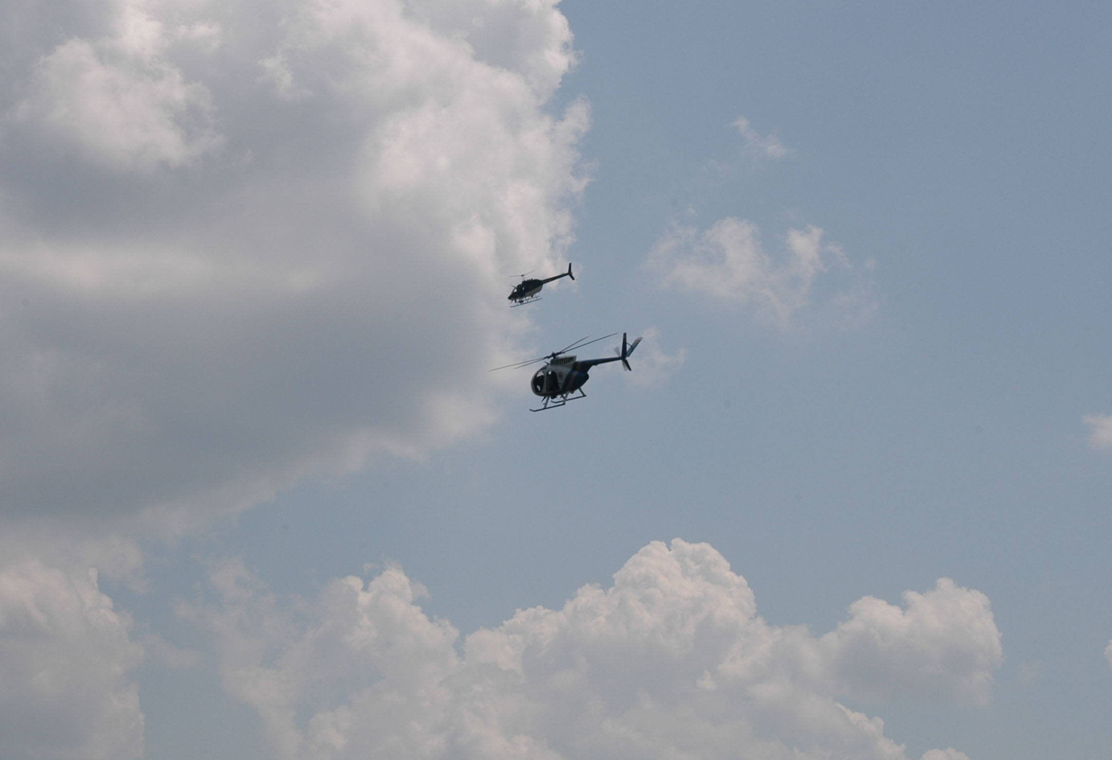

Maintenance Technician
If location of aircraft is unknown:
If a lengthy search is expected prepare aircraft, fuel supply, etc.,
Prepare flight suit/ helmet if needed as crew member for search
Prepare tools needed to respond to accident site
Once the aircraft is located:
Aircraft safe
ELT turned off
Fuel sample taken
Assist Chief Pilot/ Safety Officer with investigation
Manage aircraft recovery plan

Slide 29
Public Information Officer
Respond to command post
Usually unclear on aviation related issues
“Anything you could say the day before, you can say immediately following an accident.” i.e. N-number, occupants, mission, etc.
CANNOT discuss anything that has to do with the investigation.
CANNOT release cause (or suspected cause) of an accident investigated by the NTSB (Title 49, Ch. VIII § 830 & 831)
NTSB Public Affairs: 202-314-6100
§ 831.13 (a) Release of information during the field investigation, particularly at the accident scene, shall be limited to factual developments, and shall be made only through the Board Member present at the accident scene, the representative of the Board's Office of Public Affairs, or the investigator-in-charge.

Slide 30
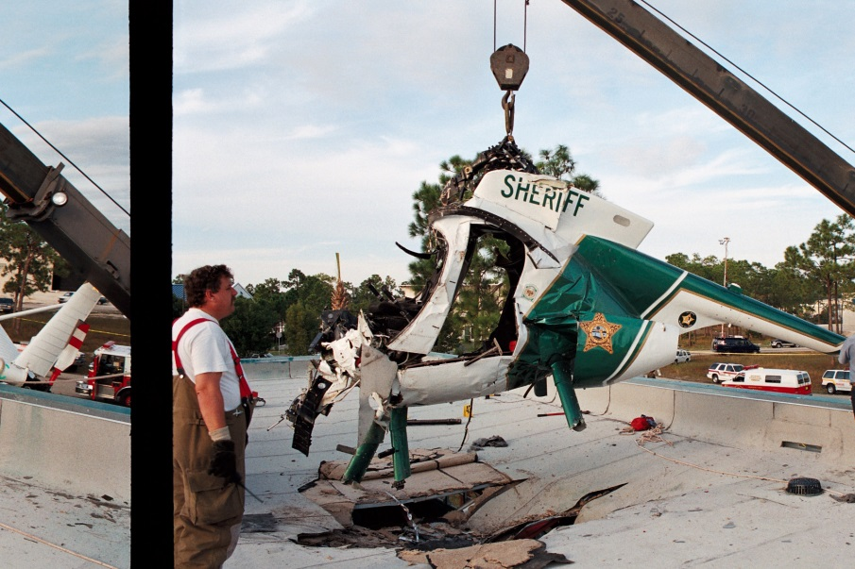
Other Resources
Nearby law enforcement/fire assets
Coast Guard/Military
Civil Air Patrol
Civilian SAR teams
ATC
If contact numbers and procedures are not laid out ahead of time and included in the plan… count on the resource not being available
when you need it!

Slide 31
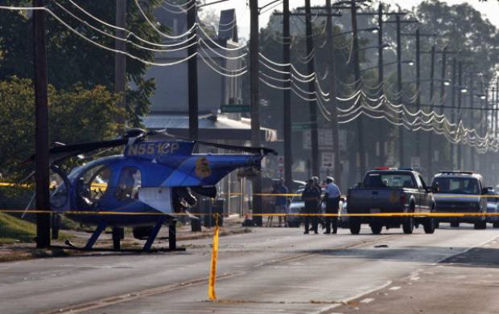
NTSB Coordination
When working with the NTSB, they have jurisdiction over the investigation
  Sometimes they may defer the investigation to the FAA or local law enforcement
  Being ‘Public Use’ does not mean the NTSB will not investigate
  The NTSB is not under DOT. They have no “regulatory or enforcement powers”. For criminal investigations the FBI takes over
You may request to be a Party to the Investigation.
You are only allowed to be a Party if:
  You are able to bring technical expertise the FAA or NTSB may not have
  You play by their rules. Usually kicked off investigation due to media releases. (Hudson River mid-air example…)
  Not allowed to be a party only to gather information
http://www.ntsb.gov/about/contact.html

Slide 32
NTSB Coordination
§ 830.5
The operator of any civil aircraft, or any public aircraft not operated by the Armed Forces or an intelligence agency of the United States, or any foreign aircraft shall immediately, and by the most expeditious means available, notify the nearest National Transportation Safety Board (NTSB) office 1 when:
(a) An aircraft accident or any of the following listed serious incidents occur:
    (1) Flight control system malfunction or failure;
    (2) Inability of any required flight crewmember to perform normal flight duties as a result of injury or illness;
    (3) Failure of any internal turbine engine component that results in the escape of debris other than out the exhaust path;
    (4) In-flight fire;
    (5) Aircraft collision in flight;

Slide 33
NTSB Coordination
(6) Damage to property, other than the aircraft, estimated to exceed $25,000 for repair (including materials and labor) or fair market value in the event of total loss, whichever is less.
(8) Release of all or a portion of a propeller blade from an aircraft, excluding release caused solely by ground contact;
(9) A complete loss of information, excluding flickering, from more than 50 percent of an aircraft's cockpit displays
(10) Airborne Collision and Avoidance System (ACAS) resolution advisories issued either:
(i) When an aircraft is being operated on an instrument flight rules flight plan and compliance with the advisory is necessary to avert a substantial risk of collision between two or more aircraft; or
(ii) To an aircraft operating in class A airspace.
(11) Damage to helicopter tail or main rotor blades, including ground damage, that requires major repair or replacement of the blade(s);
(12) Any event in which an operator, when operating an airplane as an air carrier at a public-use airport on land:
(i) Lands or departs on a taxiway, incorrect runway, or other area not designed as a runway; or
(ii) Experiences a runway incursion that requires the operator or the crew of another aircraft or vehicle to take immediate corrective action to avoid a collision.
(b) An aircraft is overdue and is believed to have been involved in an accident.

Slide 34
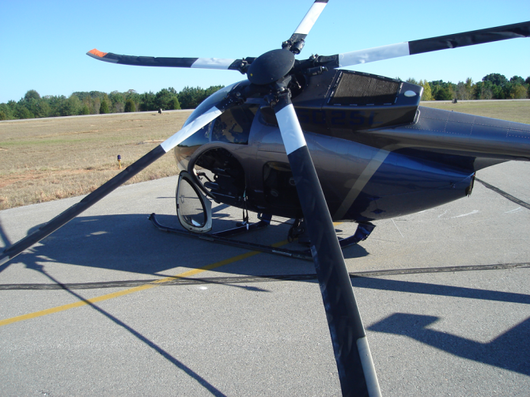
Business Continuity
NTSB identification: NYC95GA060.
aircraft: EUROCOPTER AS-350-B, registration: N20SP
injuries: 4 fatal.
A Massachusetts State Police helicopter departed a heliport with two crewmembers & two passengers, & climbed to about 600' over a river. Witnesses reported seeing a puff of "smoke" (or vapor) from the engine exhaust. The helicopter was observed to turn toward the river bank & descend at an angle between 45 & 70 degrees. Witnesses stated that the main rotor blades were either turning slowly or had stopped prior to the helicopter colliding with a boat house roof. Examination of the engine revealed that five of the six fuel injection ports were clogged. Samples from the helicopter fuel system contained iron oxide & water.
The national transportation safety board determines the probable cause(s) of this accident to be:
Fuel contamination and obstructed fuel injector nozzles, due to inadequate fuel storage and storage requirements by the MSP, resulting in a loss of engine power; and 3) the failure of the pilot to execute a proper autorotation, which resulted in a loss of rotor rpm and subsequent loss of helicopter control.
Are you going to maintain services? Full services or limited?
(Ornge Helicopters, Alachua County examples)
Have someone fill in for you?
When will you restart ops?
Mental Health needs of crew/coworkers
  Treat the same as a lethal force incident (24hrs before taking written statement, mandatory after care, etc.)
  Support for families
  It does not need to be an injury or damage causing incident to need this. Aviation incidents, even close calls, are powerful influences on mental health

Slide 35
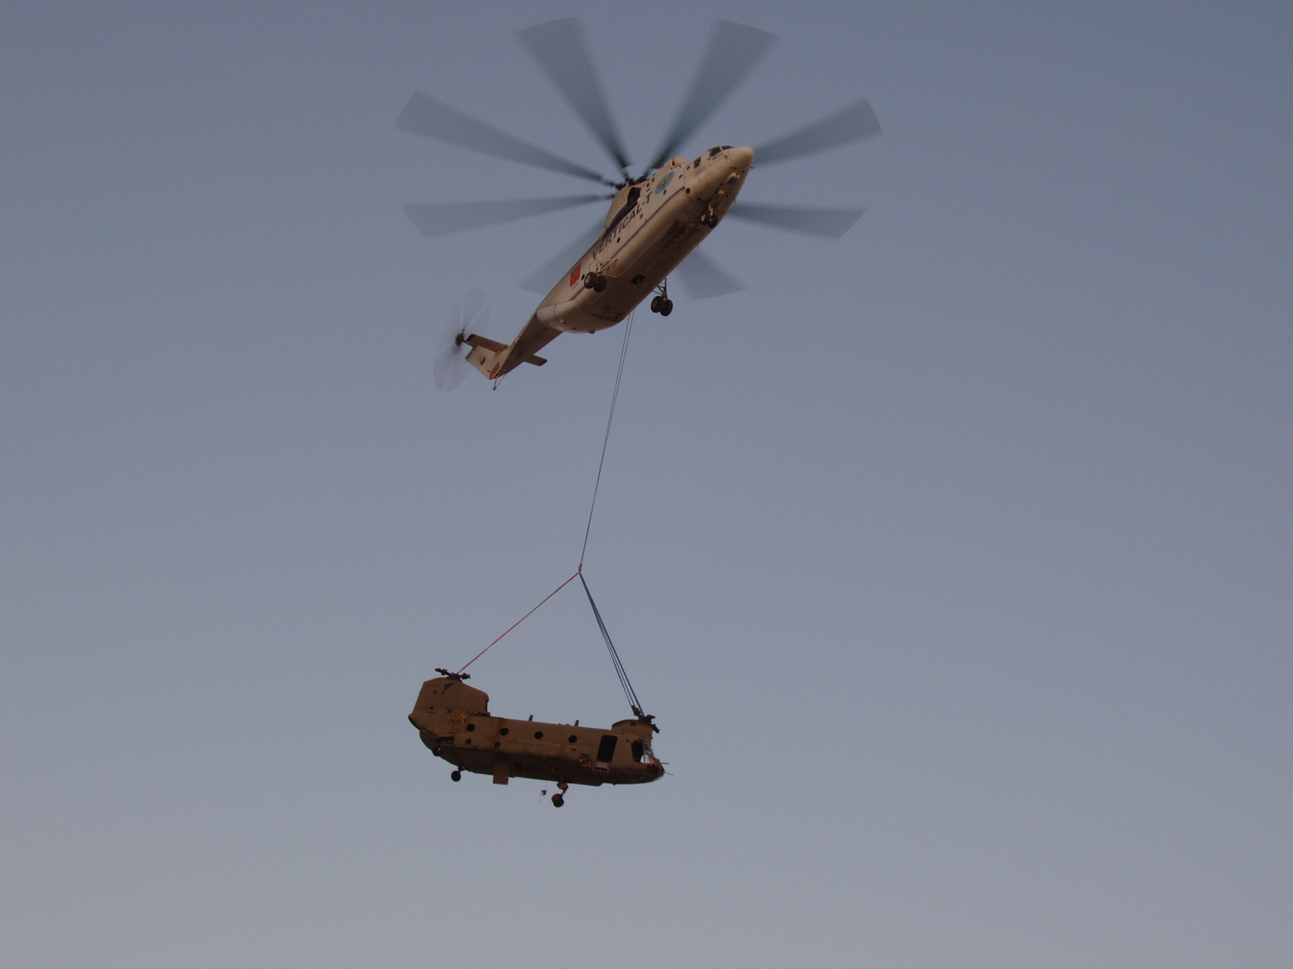
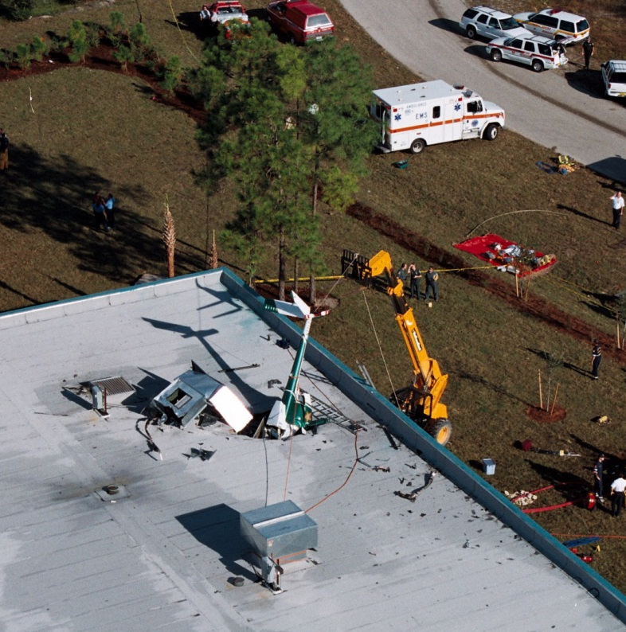
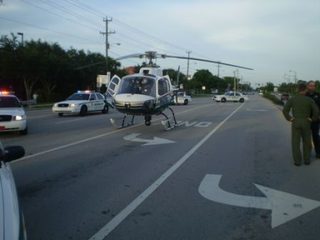
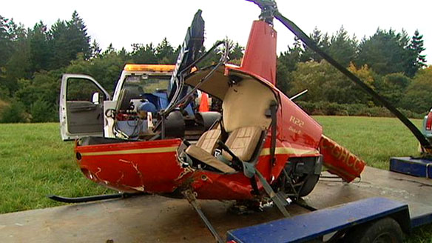
Consider Your Recovery Plan

Slide 36
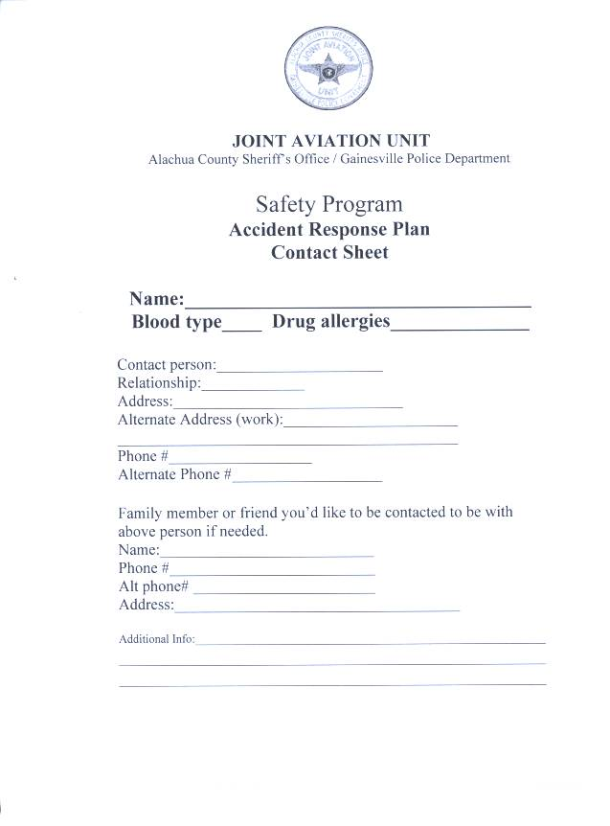
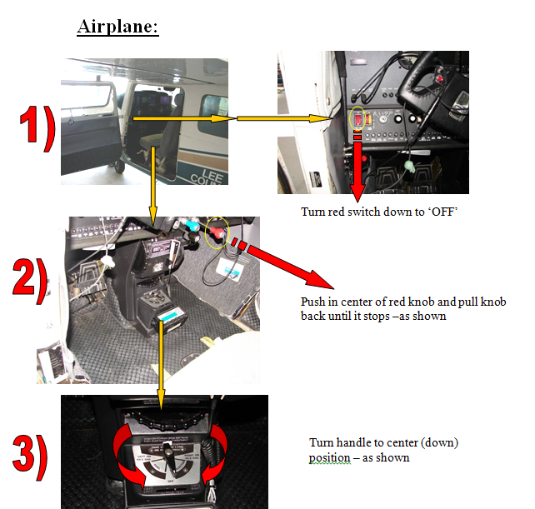
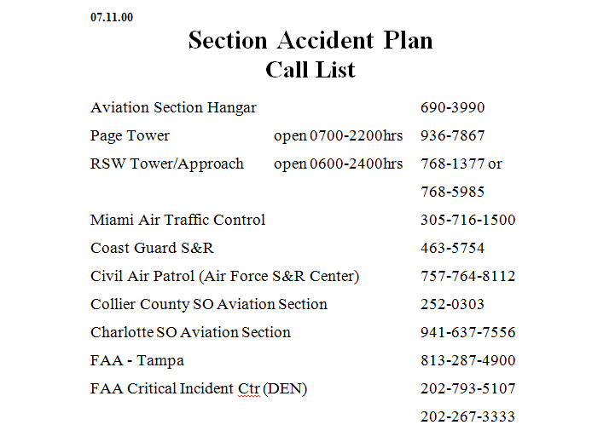

Slide 37
Implementation

Slide 38
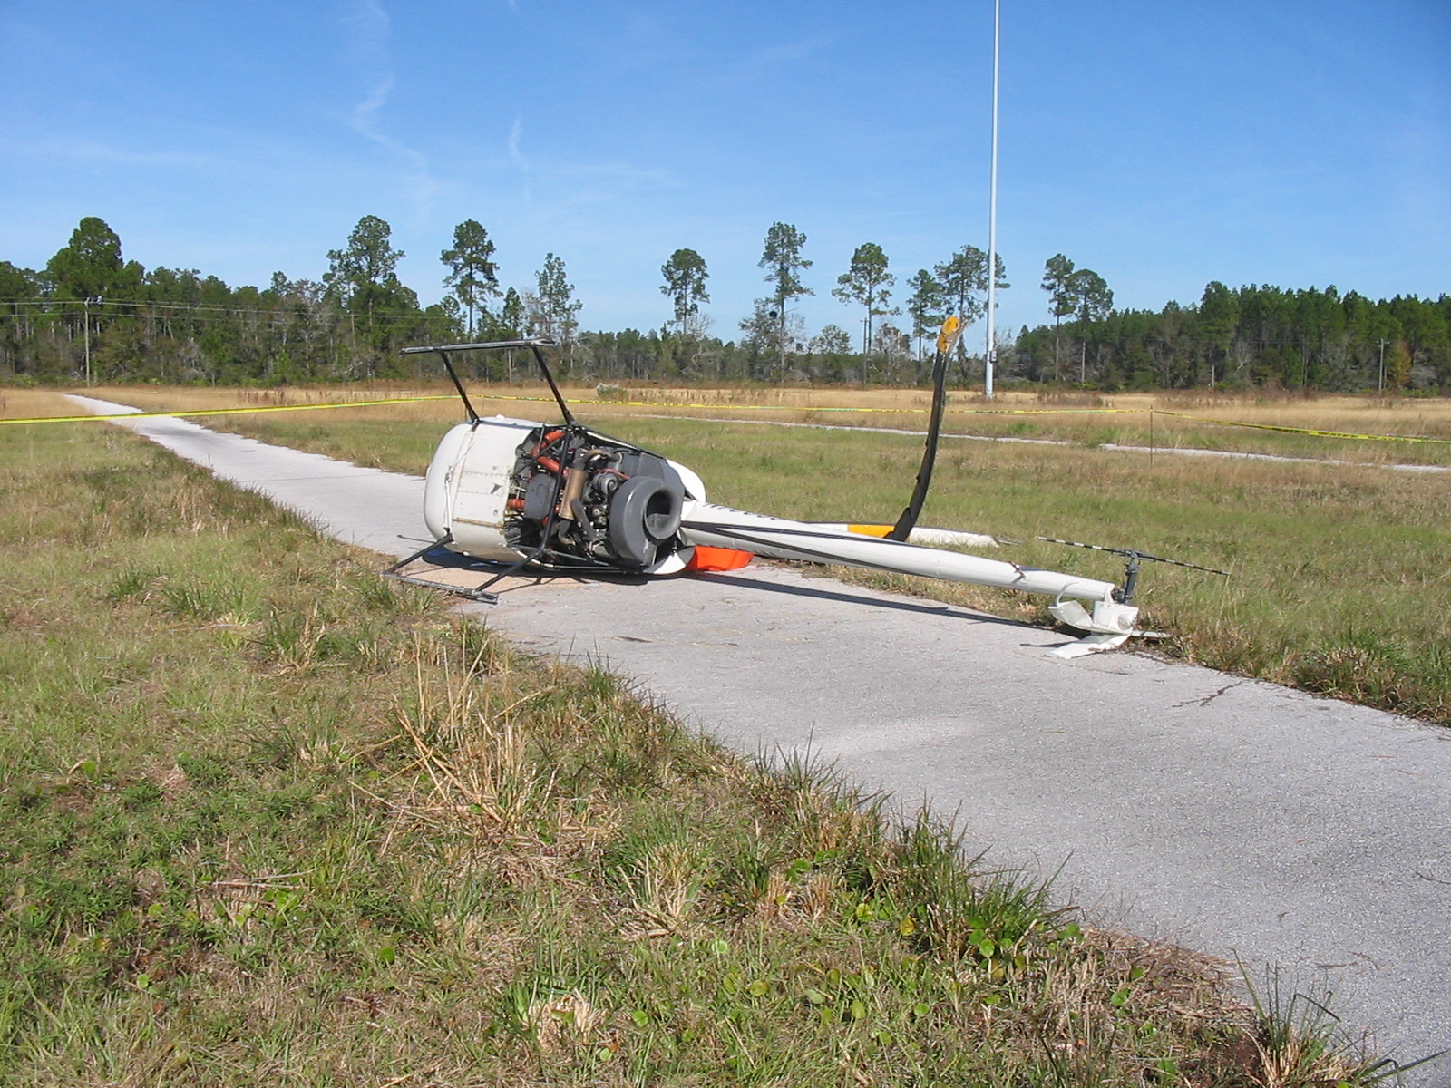
Dec. 4, 2007
R-22 Non-fatal crash near GNV

Slide 39
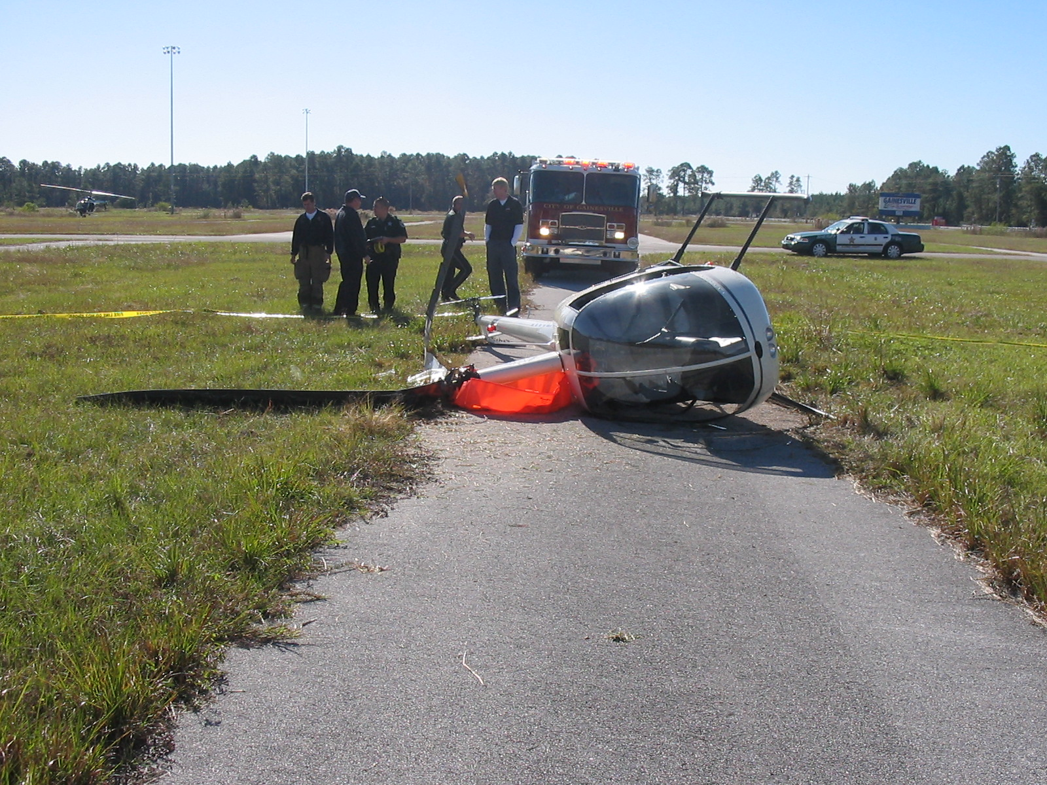
Dec. 4, 2007
R-22 Non-fatal crash near GNV
First use of our incident plan. (not agency aircraft)
Major lesson: WE knew about the plan and how to use it…but nobody else did.
Where all of the tasks were completed by unit members, the plan worked fine.
Several exercises were planned to include as many involved parties as possible.

Slide 40
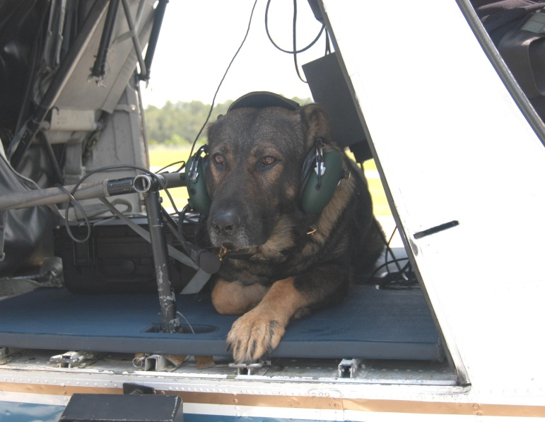
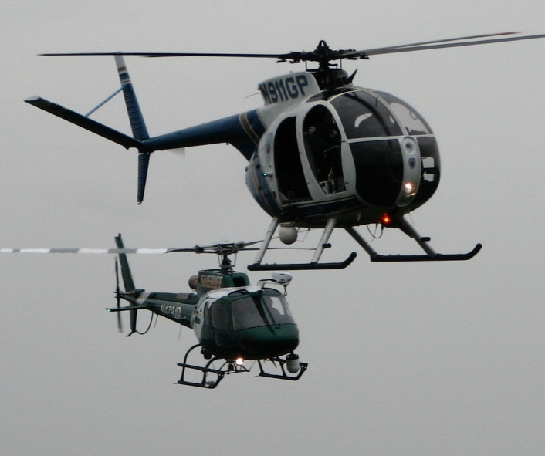
Incident Plan Exercise
Several scheduled to include more people and allow unit members to try different roles.
Only the date of the exercise was known, the time and location were unannounced.
First run-through…complete disaster!
By the last exercise (#4) everything went according to plan.

Slide 41
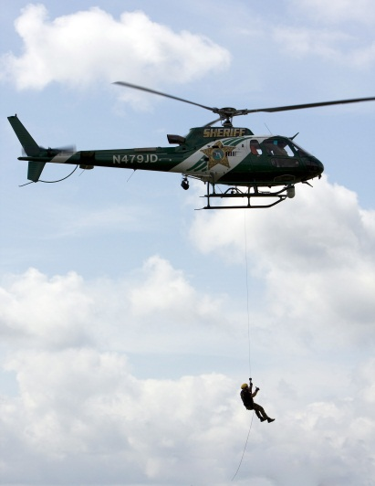
Incident Plan Exercises
Plan was edited with lessons learned:
What a pilot considers layman’s terms are often far from what the layman really understands.
Patrol officers, EMS and Fire need to be trained on how to actually respond to the scene (where to park, how to approach, fuel shut off, hazards, etc.)
Plan several sessions of the exercise in case WX or call load interferes with the schedule.
Make sure the communications center can quickly find out who is in the aircraft that is in distress.
Know how to use your ELT from the S&R side of the operation. Phone numbers for 406MHz info, CAP, Coast Guard.
Search and Rescue methods were refined.
If you didn’t learn something, you didn’t do a thorough enough test

Slide 42
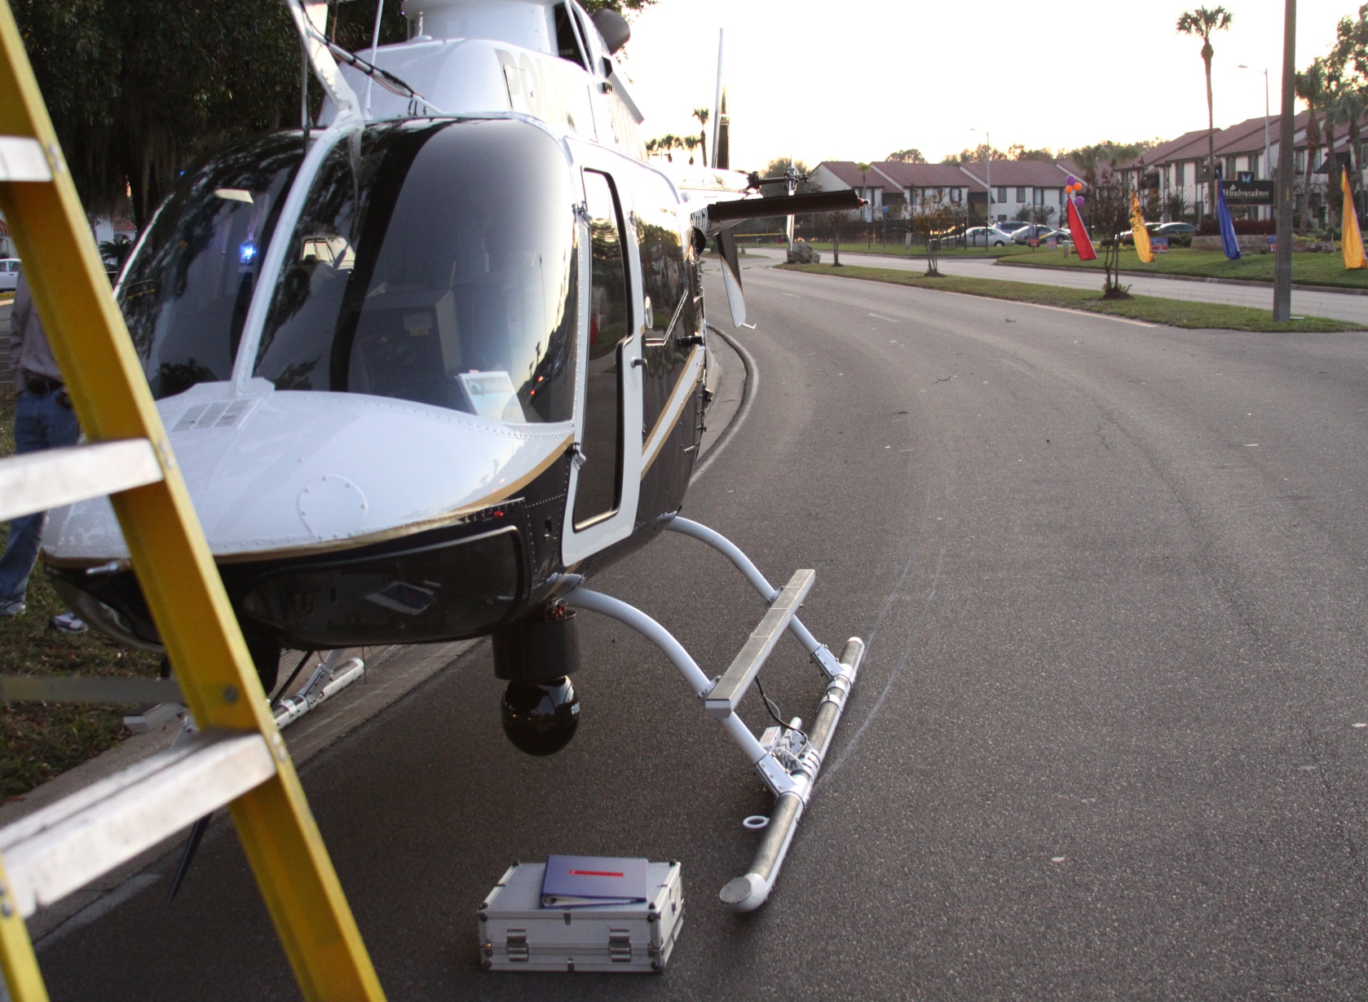
Actual Deployment of Plan

Slide 43
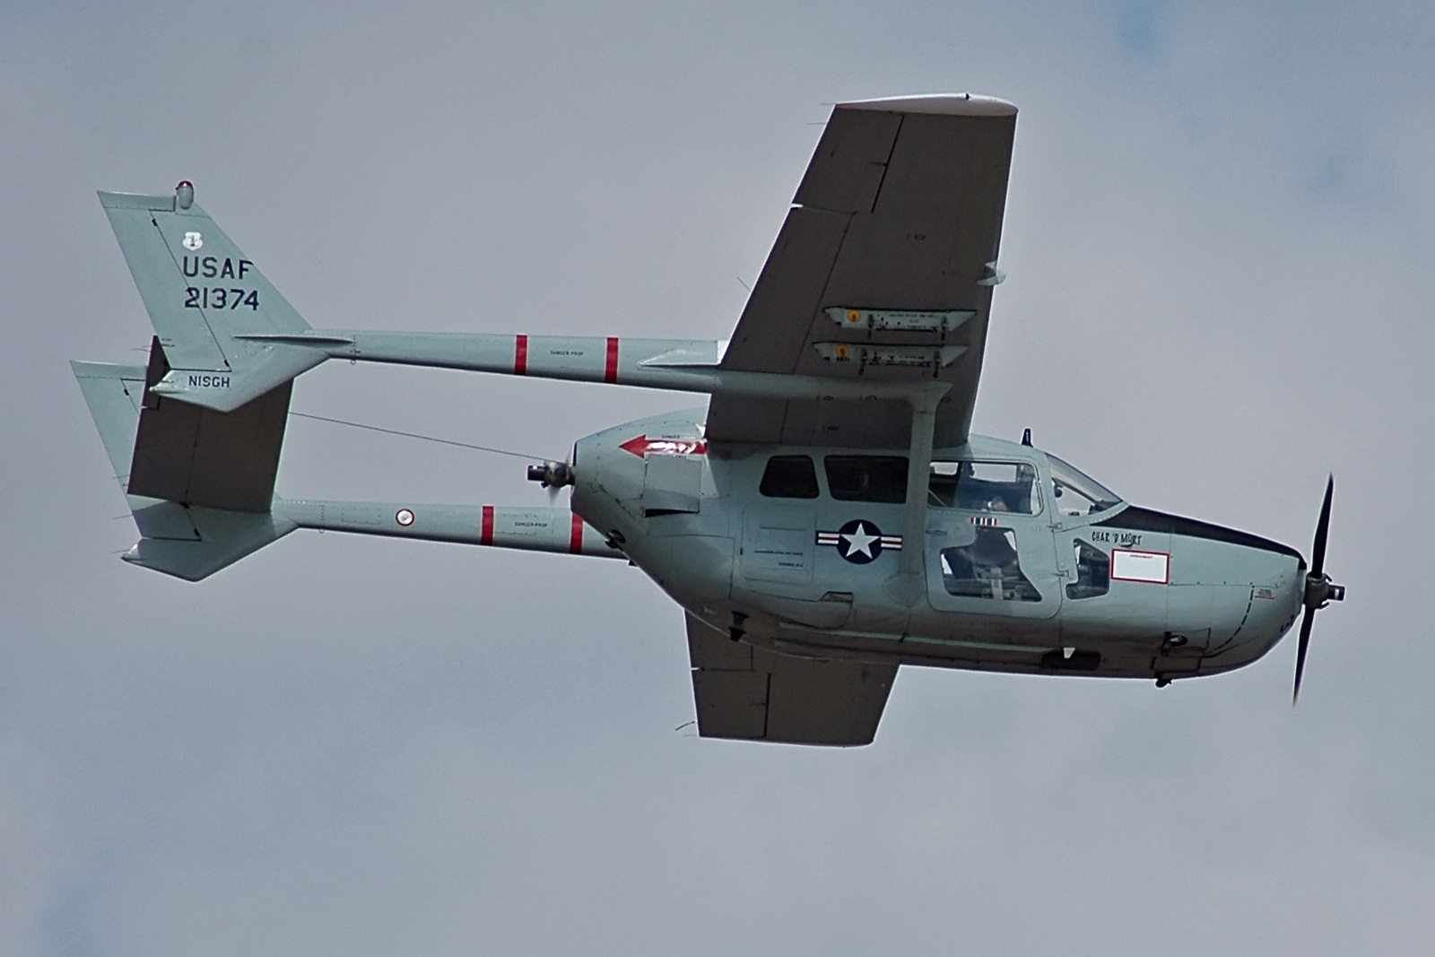
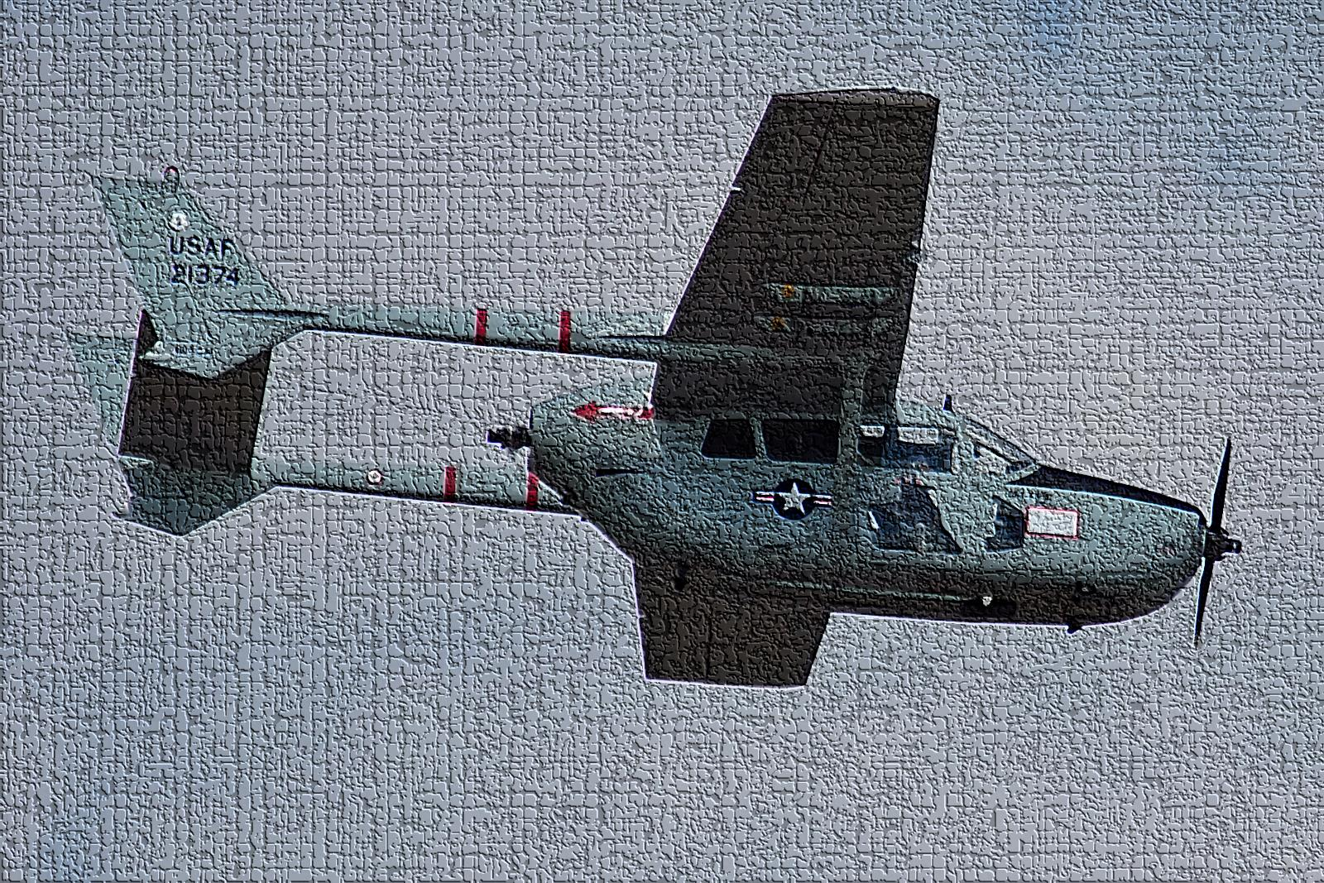
Oct 20, 2010 Cessna O-2 Fatal Crash in Avon Park
Consider the mental health needs of survivors and responders to these types of incidents. Treat them as officer involved shootings. I recommend everyone gets a visit to a mental health professional afterwards. Everyone. I know for a fact that it can have a major impact on the kinds of people who would never say a word about how an event like this really affects them.
Aircraft called 5 mile final – never heard from again
5 hour search with numerous agencies
Very good search plan, structured by Incident Commander at a centralized Command Post
Friends of crewmembers killed (3) were on scene within ten minutes of search helicopter locating the scene…

Slide 44
Conclusion
Have a plan… unless you trust a bunch of people who know nothing about aviation to take care of you and your crew after an incident.
Make specific task assignments, with a backup for each position.
Be clear, but as brief as possible.
Provide a quick reference sheet.
Provide all phone numbers and contact procedures for any resource you may need.
Make the plan accessible to everyone involved (have it in the car, at the desk, intranet).
Include a plan to protect the crew and their family (data sheets).
Have a trained aircraft accident investigator in the unit.
Put together an accident response kit with everything needed to work the incident site.
Then practice the plan!

Slide 45
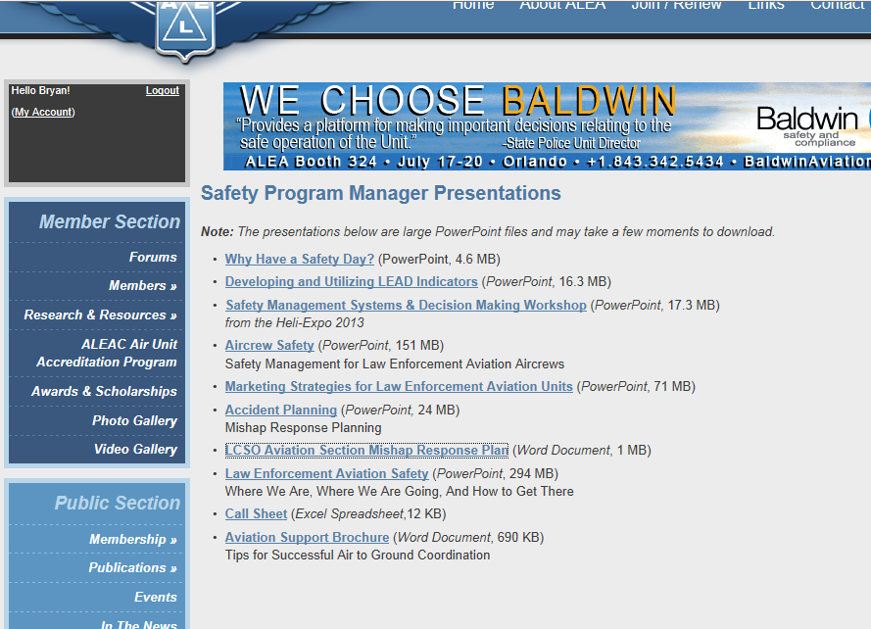

Conclusion
Sample Plans…
https://www.dropbox.com/sh/y2tgxbz2iirkht8/vrgrqlIsWI/Mishap%20Plan.doc

Slide 46
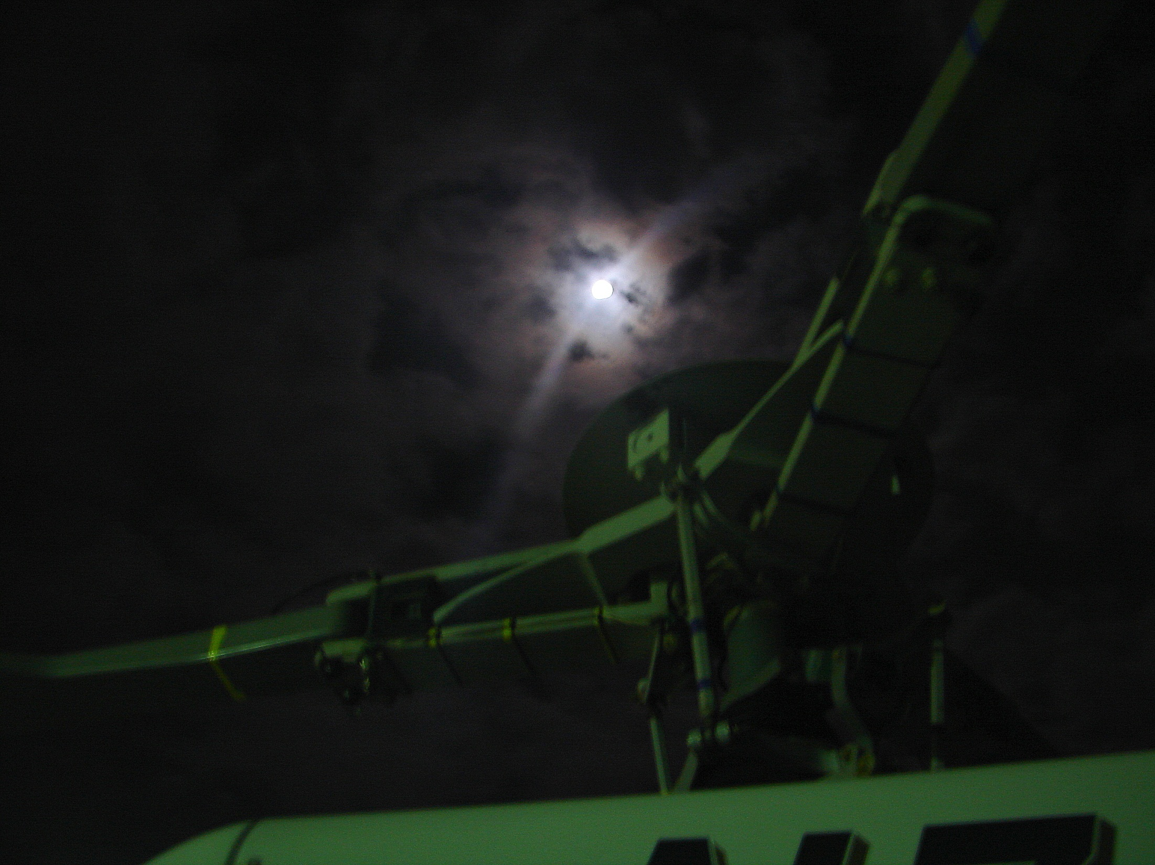
There are no new ways to crash an aircraft…
…but there are new ways to keep people from crashing them
Bryan Smith
Safety Program Manager
safety@alea.org
239-938-6144

