Slide 1


What the FRAT?
Flight and Ground Risk Analysis Tool
(FRAT/GRAT)

Slide 2
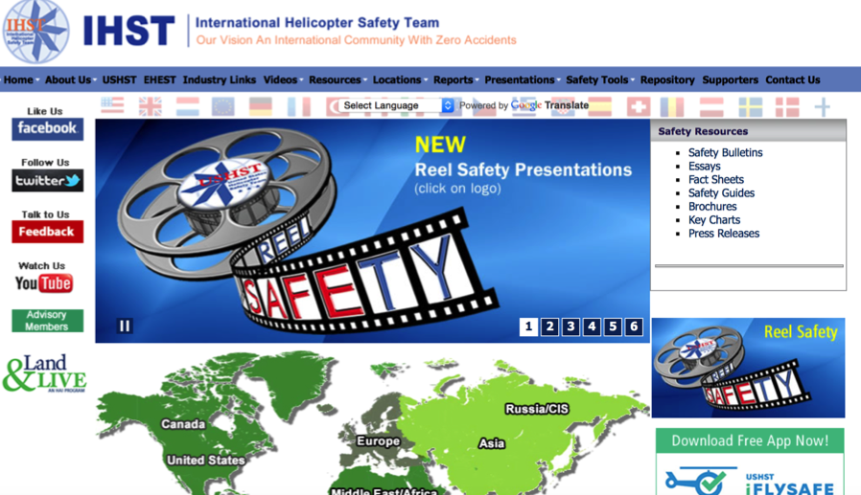
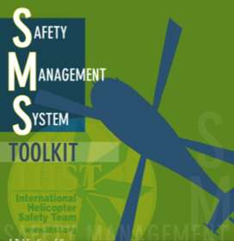
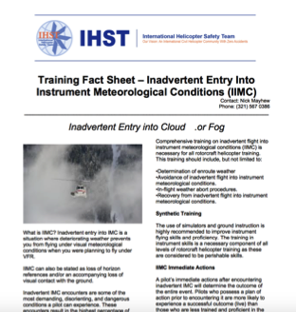
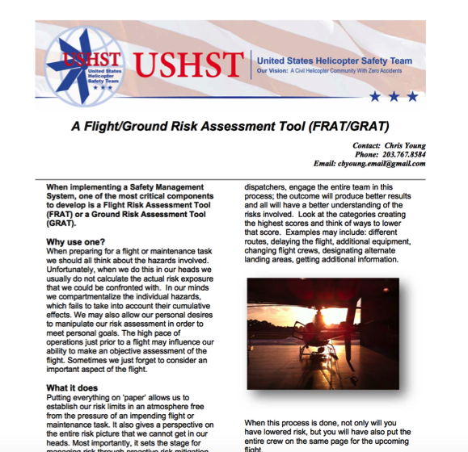
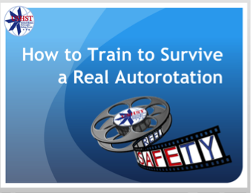
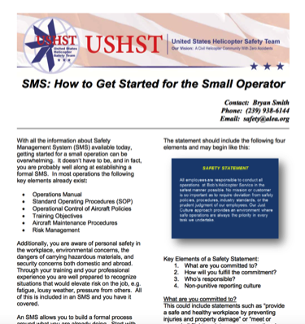
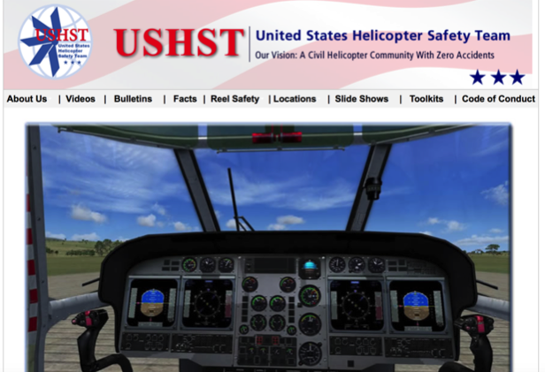

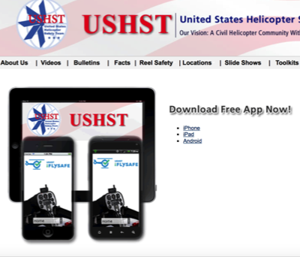
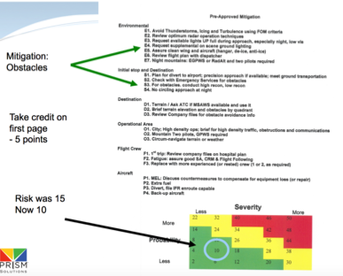

Slide 3

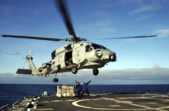

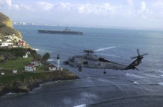











Chris

Slide 5
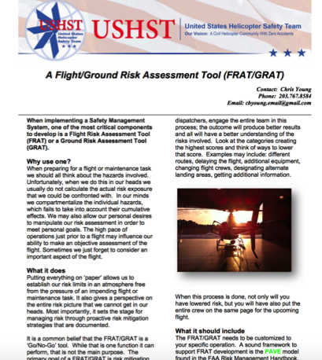
Flight Plan…
Purpose of a Risk Assessment Tool
Key Elements
Real World Application
Role Within Your SMS
Regulatory Requirements

Slide 6


Safety Management System (SMS) implementation
Requires a……
Flight and Ground Risk Analysis Tool
(FRAT/GRAT)
WHY?

Slide 7

Purpose of a FRAT
WHY?
How many of you know it is dangerous to:
How many of you have:
Flown in weather you probably shouldn’t have been in
Fly in weather the aircraft is not certified for
Performed flight or maintenance tasks when fatigued or sick
Perform flight or maintenance tasks when fatigued or sick
Pushed fuel further than you’d like your mentor to know about
Push flights to the very limits of fuel capacity
Operated aircraft or done critical maintenance without all the training you should have had
Operate aircraft or do critical maintenance without proper or recent training

Slide 8



Purpose of a FRAT
In our minds we compartmentalize the individual hazards, which fails to take into account their cumulative effects.
We may also allow our personal desire to manipulate our risk assessment in order to meet personal goals.
The high pace of operations just prior to a flight may influence our ability to make an objective assessment of the flight.
Sometimes we just forget to consider an important aspect of the flight.
When preparing for a flight or maintenance task we should all think about the hazards involved.
In our heads we do not calculate the actual risk exposure that we could be confronted with.
Weather
Aircraft
Performance
Personal
Life
Experience
Fatigue

Slide 9


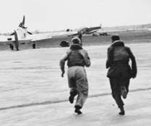

Purpose of a FRAT
Weather
Weather
Aircraft
Performance
+
Performance
+
Personal
Life
Fatigue
Experience
+
Personal Life
Fatigue
+
Experience
+
Stuff I forgot
=
Actual Risk

Slide 10
Purpose of a FRAT
Weather
Safety Decisions
+
GO
Performance
+
Not Quite…
=
Fatigue
+
Removed from aircrew or technician
NO GO
Personal Life
+
Experience
+
Stuff I forgot
=
Actual Risk

Slide 11
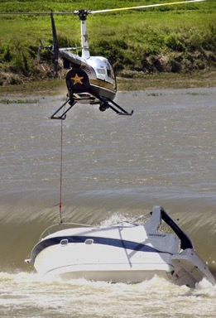
Purpose of a FRAT
While Go/No Go guidance is one function it can perform, that is not the main purpose.
The primary goal of a FRAT/GRAT is risk mitigation.
Once the risk picture has been painted, we look at ways to lower that risk.
Take a PAUSE – “Did I Miss Something”
“Could have used a FRAT today”

Slide 12
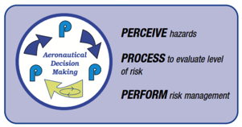
Purpose of a FRAT
Facilitate the "3Ps”:
  PERCEIVE hazards (cross-check);
  PROCESS level of risk (interpret);
  PERFORM risk management (control).
Accept no unnecessary risk
Make risk decisions at the appropriate level
Accept risk when benefits outweigh costs (i.e. dangers)
Integrate risk management into planning at all levels
Notes:
• As you perceive (cross-check), the goal is to identify hazards, which are events, objects, or circumstances that could contribute to an undesired event. For example, a large nick in the tail rotor blade is a hazard.
• As you process (interpret), the goal is to determine whether the hazards you have identified constitute risk, which is the future impact of a hazard that is not controlled or eliminated. The degree of risk posed by a given hazard can be measured in terms of exposure (number of people or resources affected), severity (extent of possible loss), and probability (the likelihood that a hazard will cause a loss).
• In order to perform (control) by mitigating the risk identified in the perceive and process stages, you need to determine what you can do to maximize safety (i.e., freedom from those conditions (hazards) that can cause death, injury, or illness; or damage to equipment, property, or the environment).

Slide 13
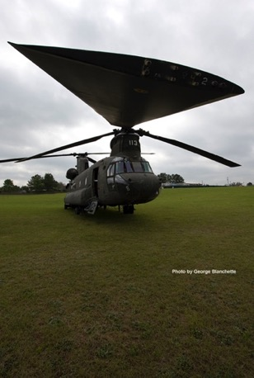
Purpose of a FRAT
The FRAT must always remain a ‘Tool’ to help think about risk exposure
The aircrew or technician can use this tool to get work done as safely as possible (ALARP)
The tool works to enhance technical knowledge and skills, not to make decisions in spite of them

Slide 14
Flight Plan…
Purpose of a Risk Assessment Tool
Key Elements
Real World Application
Role Within Your SMS
Regulatory Requirements
Key Elements
List of Hazards
Risk Determination
Mitigation Function
Static and Dynamic Sections
Risk Score Ranges

Slide 15
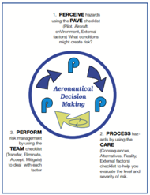
Key Elements
What it should include…
The FRAT/GRAT needs to be customized to your specific operation.
Have items that are part of your ideal flight or task briefing
A sound framework to support FRAT development is the PAVE model found in the FAA Risk Management Handbook.

Slide 16
Key Elements
Pilot (Persons) – Experience, training, fatigue, illness, [I’M SAFE checklist]
Aircraft – Known maintenance issues, performance limitations, fuel status, avionics updates.
enVironment – Weather (present and forecast), flight (mission) type, ATC, obstructions, time of day, other air traffic
External Pressures - Recent changes in personnel, management insistence, difficult customers, consequences of cancelling flight.

Slide 17
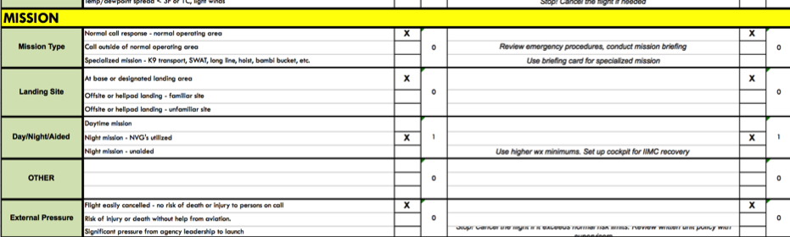

Key Elements
TIP– Do not assume you can identify all hazards that will be encountered.
Include a blank ‘Hazard’ that can be filled in if needed.
This will allow a crew to still do the most important part of a FRAT if something was missed in the Hazard ID process…
Mitigation

Slide 18

Key Elements
Risk can be determined in various ways
Element present or not (passengers, special op)
Variable levels (VFR-MVFR-IFR, hours on shift)
In conjunction with other elements (weather and time of day, experience level and job complexity)

Slide 19
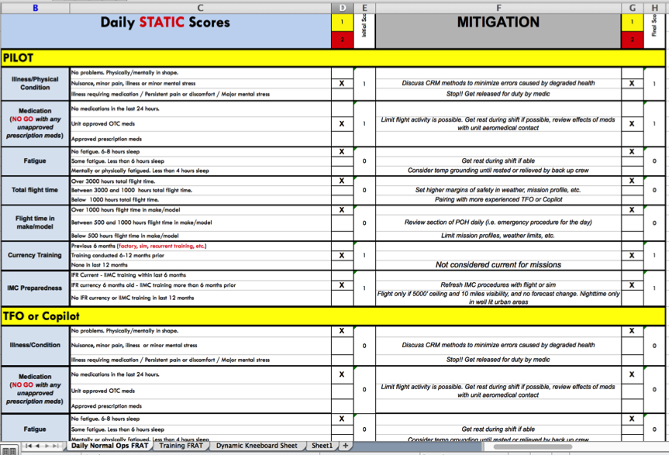
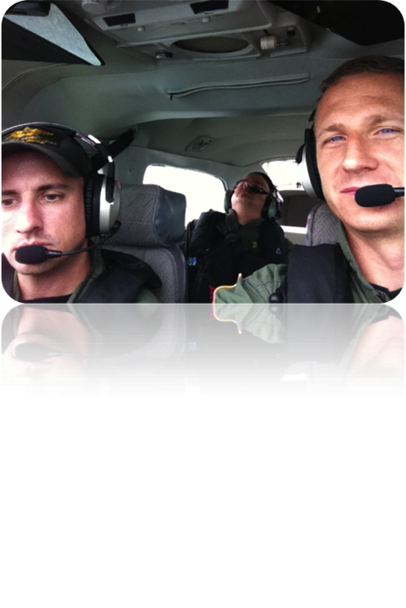
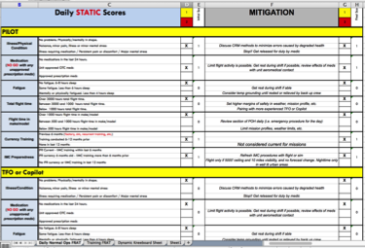
Key Elements
✔
Pilot (Persons) – Experience, training, fatigue, illness, [I’M SAFE checklist]
The entire aircrew or maintenance team should be included in this section…
✔

Slide 20
Key Elements
Your FRAT/GRAT must include a Mitigation function.
This is the key to the whole process!
Look at the high scoring items and think of a way to reduce that risk.
GO
Hazard Identification
Risk Assessment
MITIGATION
NO GO

Slide 21
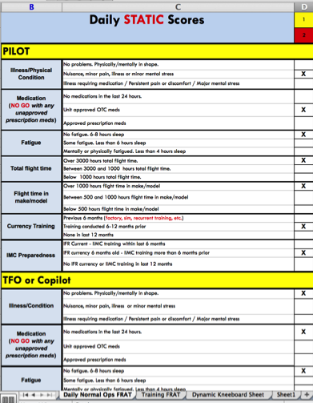
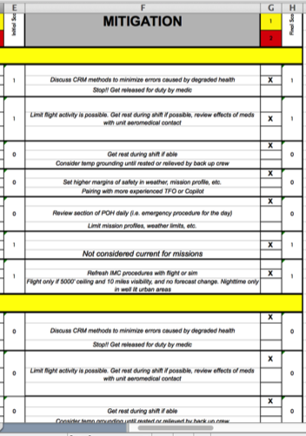
Key Elements
Examples may include:
Different route
Delaying the flight
Additional equipment
Changing flight crews
Designating alternate landing areas
Getting additional information
Setting higher limits for training maneuvers
Reviewing procedures
Consulting other flight crews
Many, many more….

Slide 22
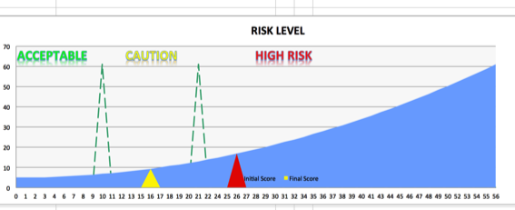
Key Elements
When this process is done, not only will you have lowered risk, but you will have also put the entire crew on the same page for the upcoming flight.
You may even find a way to get a job done that you would have otherwise turned down…

Slide 23
Key Elements
If your operation flies unscheduled flights your FRAT should include ‘static’ and a ‘dynamic’ sections.
The static section includes the elements that are unlikely to change throughout the day. This will usually be the bulk of your FRAT and can be filled out at the beginning of a shift.
The dynamic section includes those items that can only be filled out when the time and specifics of a flight are known, often just before the flight.

Slide 24
Key Elements
What do I do with the final score?
The FRAT/GRAT should have three possible score ranges. These are often grouped into Green, Yellow and Red sections.

Slide 25
Key Elements
What do I do with the final score?
Green – Go fly!
The pilot/crew still want to discuss what the highest scoring risks are and attempt to mitigate those risks.

Slide 26
Key Elements
What do I do with the final score?
Yellow – Try to mitigate some of the higher scoring items.
If the score is still in the yellow, call a contact person. That contact person must understand aviation safety, which usually means another pilot with safety or management status.
They will help think of ways to further mitigate some of the risks for the flight.
If the score is still in the yellow, the contact person can release the flight with the knowledge from all involved that the flight is being conducted in an elevated risk category.

Slide 27
Key Elements
What do I do with the final score?
Red – No-Go.
Unless the risks involved in the flight can be mitigated (different crew or equipment, delayed launch time…) the flight is cancelled.
High scoring elements should be addressed in a company SMS.

Slide 28
Flight Plan…
Purpose of a Risk Assessment Tool
Key Elements
Real World Application
Role Within Your SMS
Regulatory Requirements

Slide 29
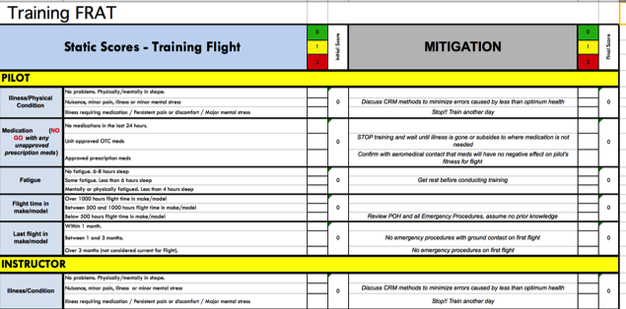
Real World FRATs
One FRAT does not fit all…
Even at the same operation…
Having different FRAT for different types of missions helps make each one:
    More effective
    Shorter in length

Slide 30




Real World FRATs
At the ab initio flight training level, a SMS or Personal Risk Management System allows you to build a formal process for ground and flight operations.
SMS is based on four pillars: safety policy, risk management, safety assurance and safety promotion.
The first two are vitally important components when teaching pilots in training about SMS. Pilots who are trained in being dedicated to safety and managing risk will easily move forward in the helicopter industry and more complex companies or a corporate SMS program.
SAFETY POLICY
RISK MANAGEMENT
SAFETY ASSURANCE
SAFETY PROMOTION

Slide 31
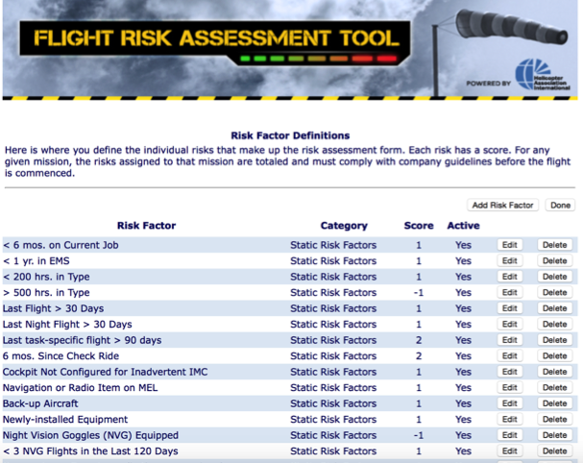
Real World FRATs
Many FRATs do not have a mitigation section
You can easily add this function by having items with a negative value…

Slide 32
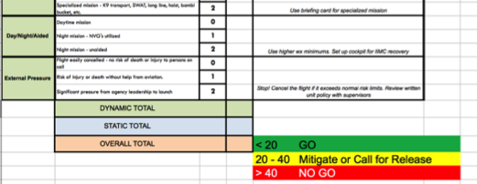
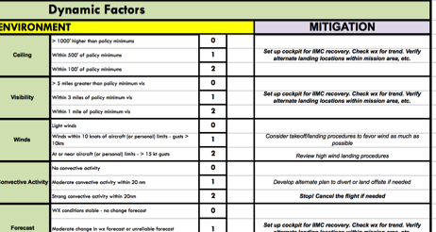
Real World FRATs
The Dynamic section of your FRAT may need updating inflight or at a remote location…
5
12
17
Put it on a kneeboard sized card…
1. Write down the static score before the flight
2. The yellow and red limits are already set
3. Calculate dynamic factors and add that score

Slide 33
Real World FRATs
Elements of a good FRAT/GRAT…
Customized to your operation.
Easy to fill out – use automation to fill in items whenever possible.
‘Living document’ – the FRAT/GRAT should change as your operation changes.

Slide 34
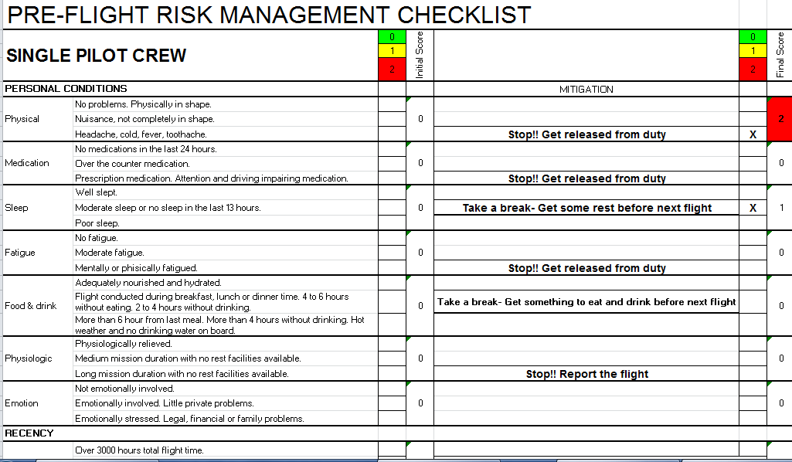
Real World FRATs
Example Risk Assessment Form:
The above FRAT can be obtained at no cost from the European Aviation Safety Agency (EASA).
https://easa.europa.eu/essi/ehest/2012/06/pre-departure-check-list

Slide 35
Real World FRATs
Doing it right…

Slide 36
Real World FRATs
Example Risk Assessment Form:
The above FRAT can be obtained at no cost from the European Aviation Safety Agency (EASA).
https://easa.europa.eu/essi/ehest/2012/06/pre-departure-check-list

Slide 37
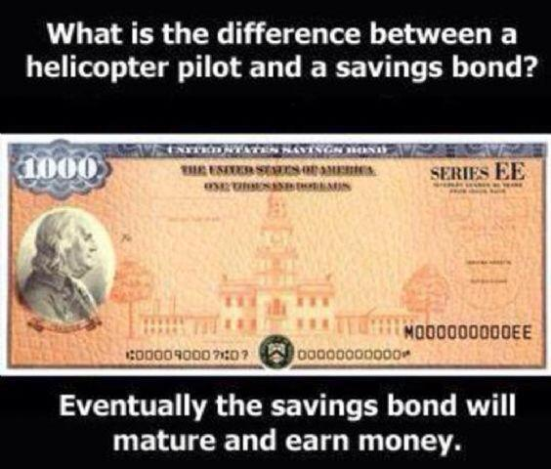
Flight Plan…
Purpose of a Risk Assessment Tool
Key Elements
Real World Application
Role Within Your SMS
Regulatory Requirements

Slide 38
SMS and the FRAT
A FRAT/GRAT is an active component of an SMS.
Risks specifically targeted by your SMS and the mitigations you develop to counter them should be included in your FRAT/GRAT.
If a hazard is generating a higher risk assessment score, increase the score on the FRAT/GRAT, and vice-versa.

Slide 39
SMS and the FRAT
SMS and the FRAT/GRAT…
Track the results of your FRATs/GRATs, especially the high scores.
Periodically analyze the data to see what those high scores are and what the real or potential impact is on your organization.
Feed that information into your SMS to drive training, equipment purchases or policy changes that can lower risk in general and also lower the number of cancelled flights in your operation.

Slide 40
SMS and the FRAT
SMS and the FRAT/GRAT…
Use FRAT/GRAT data to determine if specific risk mitigations (training, procedures, equipment) are having the desired effect, a.k.a Risk Management Assurance.

Slide 41
Flight Plan…
Purpose of a Risk Assessment Tool
Key Elements
Real World Application
Role Within Your SMS
Regulatory Requirements

Slide 42
Do I Have to FRAT?
FAR §135.617…
Each certificate holder conducting helicopter air ambulance operations must establish, and document in its operations manual, an FAA-approved preflight risk analysis that includes at least the following—
Flight considerations, to include obstacles and terrain along the planned route of flight, landing zone conditions, and fuel requirements;
(2) Human factors, such as crew fatigue, life events, and other stressors;
(3) Weather, including departure, en route, destination, and forecasted;
(4) A procedure for determining whether another helicopter air ambulance operator has refused or rejected a flight request; and
(5) Strategies and procedures for mitigating identified risks, including procedures for obtaining and documenting approval of the certificate holder’s management personnel to release a flight when a risk exceeds a level predetermined by the certificate holder.

Slide 43
Do I Have to FRAT?
FAR §135.617…
(c) Prior to the first leg of each helicopter air ambulance operation, the pilot in command must conduct a preflight risk analysis and complete the preflight risk analysis worksheet in accordance with the certificate holder’s FAA-approved procedures. The pilot in command must sign the preflight risk analysis worksheet and specify the date and time it was completed.
(d) The certificate holder must retain the original or a copy of each completed preflight risk analysis worksheet at a location specified in its operations manual for at least 90 days from the date of the operation.

Slide 44
Do I Have to FRAT?
FAA Rule 2014-03689…
“Requirement for management approval of flights in situations where a predetermined risk level is exceeded.”
“…an electronic signature would be acceptable. FAA guidance on electronic signatures is found in Advisory Circular (AC) 120–78”
“The 90-day retention will allow the operator to conduct a quarterly review to identify trends in its operations to further mitigate risks in future flights.”

Slide 45
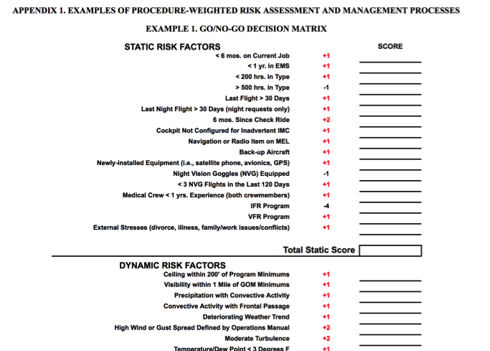
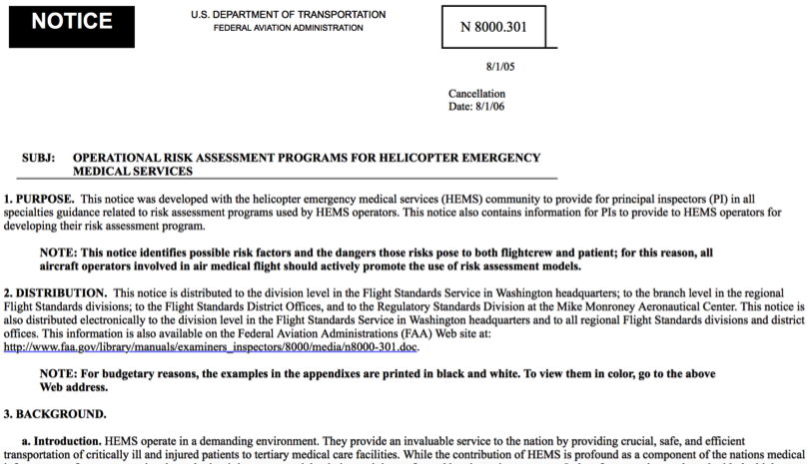
Do I Have to FRAT?
FAA Rule 2014-03689…
“The initial regulatory evaluation estimated that the preflight risk analysis would take 10 minutes to complete. The FAA has determined that a 10-minute delay is acceptable because of the safety benefit of identifying risks before flight.” ?????

Slide 46
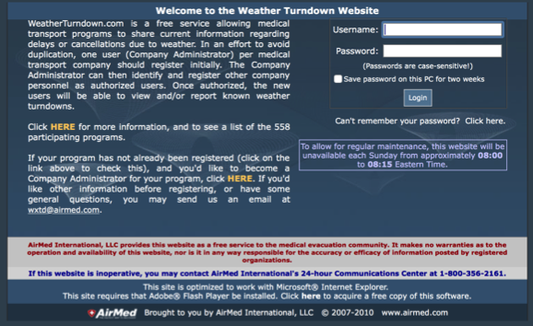
Do I Have to FRAT?
“The rule requires operators to establish and document, and include in their FAA-approved preflight risk analysis, a procedure for determining ‘‘whether another helicopter air ambulance operator has refused or rejected a flight request.’’

Slide 47


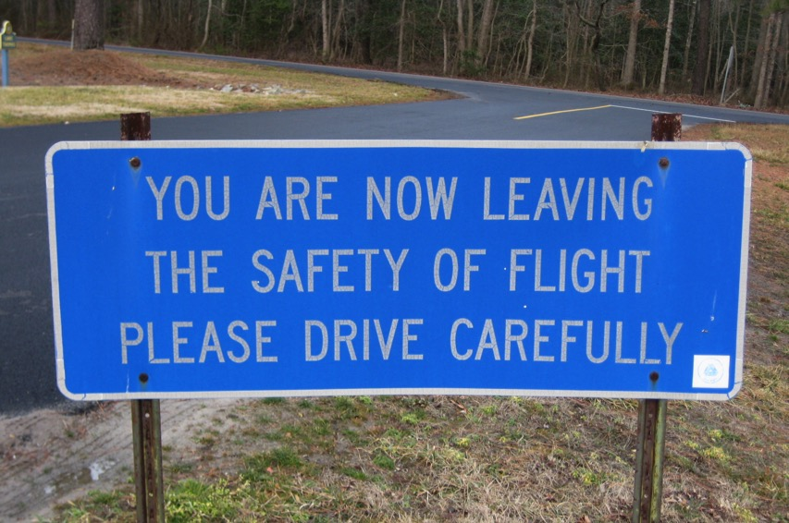
There are no new ways to crash an aircraft…
…but there are new ways to keep people from crashing them…
Chris Young
chris.young@prism.aero
203-767-8564
Bryan Smith
safety@alea.org
407-222-8644

